Slide 1

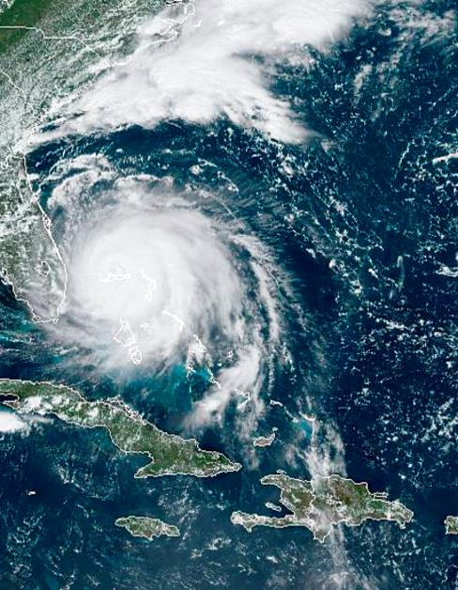


NOAA’s Operational Geostationary Satellite Mission
Dan Lindsey, GOES-R Program Scientist
Pam Sullivan, GOES-R/GEO-XO Program Director
NOAA
National Environmental Satellite, Data, and Information Service

Slide 2
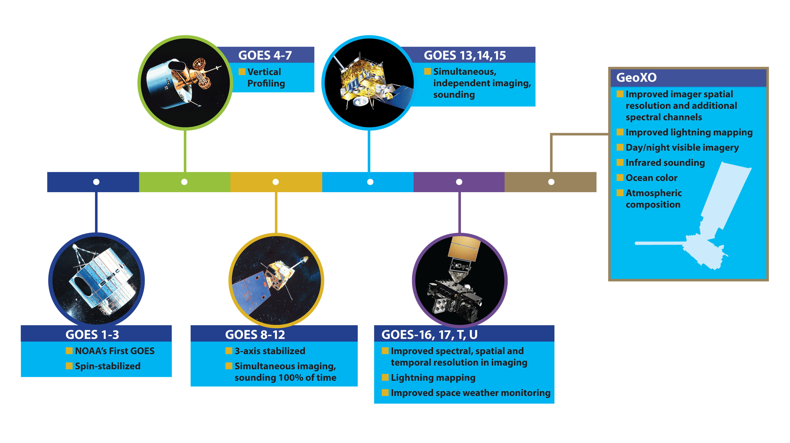
History of Geostationary Operational Environmental Satellites

Slide 3
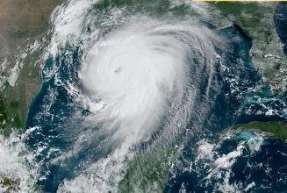
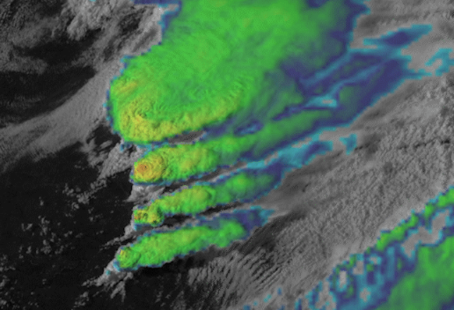
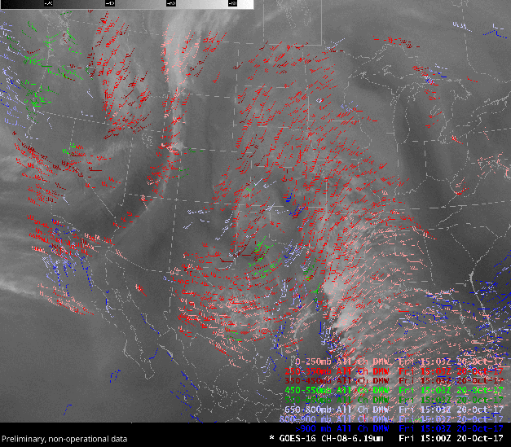
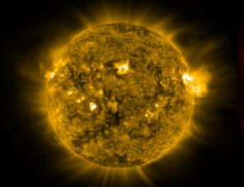
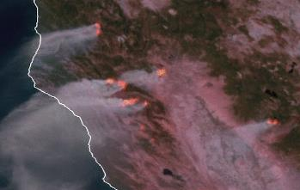
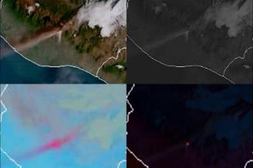
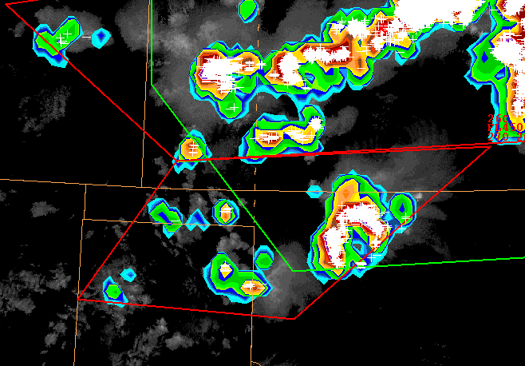
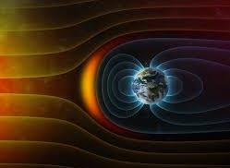
Background: Current GOES-R Capabilities
Imagery and Lightning data provided by GOES satellites are essential for field office operations for mesoscale and short-range forecasting, and for issuing watches and warnings
Solar and in situ measurements provide data for space weather forecasts and warnings
Tropical Cyclone Tracking and Evolution
Severe Storms
Atmospheric Winds
Solar Activity
Wildfire Detection and Characterization
Volcanic Ash Tracking
Lightning
Space Weather
In Situ Conditions

Slide 4
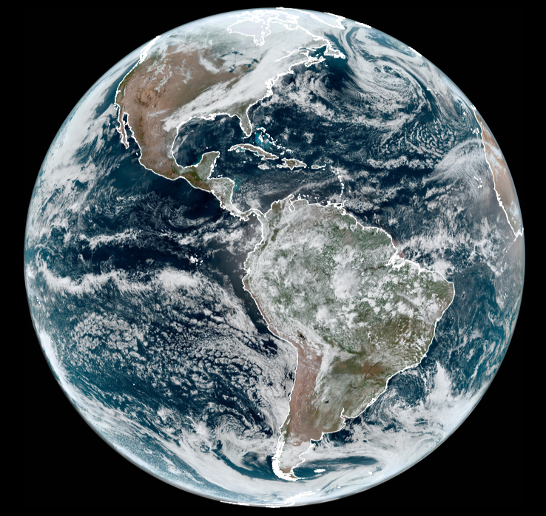
GOES-East (currently GOES-16)
Launched in late 2016, operational as GOES-East since 18 December 2017
Provides coverage of North and South America, the tropical and north Atlantic, and the east Pacific
Its ABI and GLM provide guidance to severe storm forecasters

Slide 5
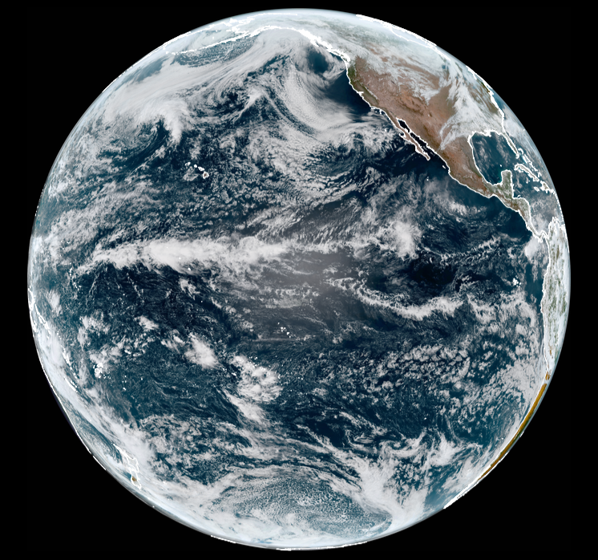
GOES-West (currently GOES-17)
Launched in March 2018, operational as GOES-West since 12 February 2019
Provides coverage of North America, Alaska, Hawaii, and much of the Pacific Ocean
Its ABI has a problem with the cooling system, resulting in degraded and missing IR channels are certain times of the night; varies seasonallyi

Slide 6
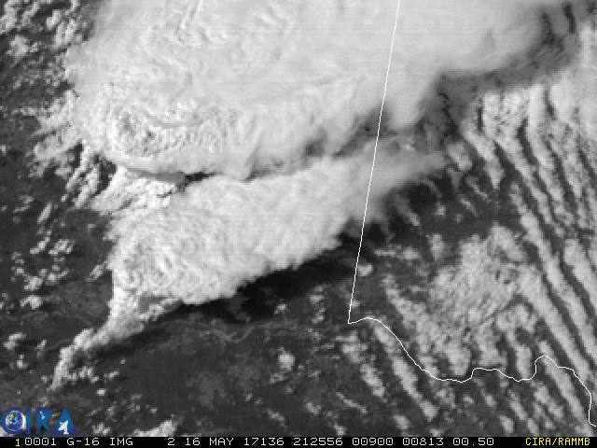
GOES-16 – 1 min band 2 VIS imagery – Texas and Oklahoma

Slide 7
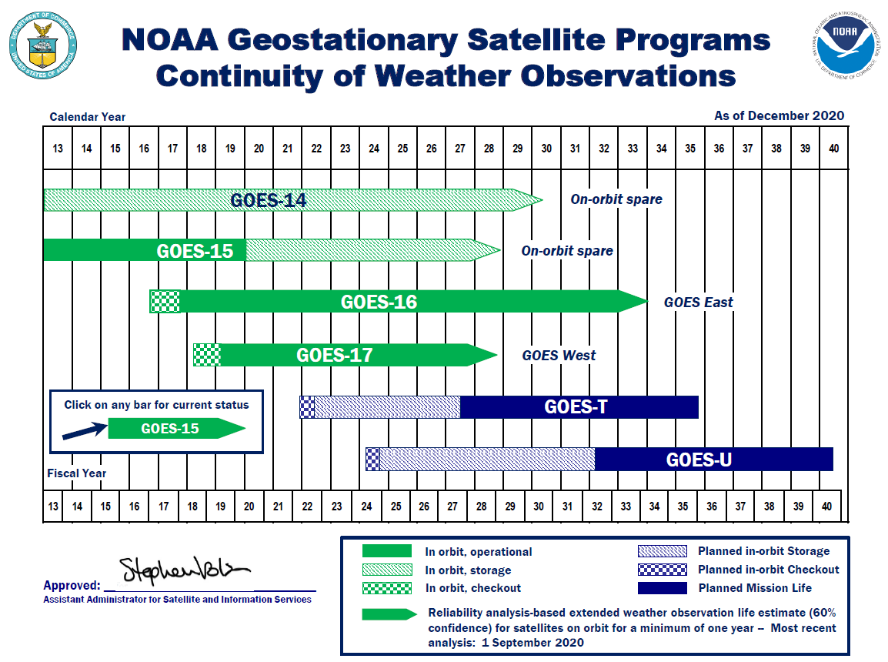
The Next Geo System, GEO-XO, is Needed by 2032
Loss of on-orbit spare;
Risk to GEO data continuity

Slide 8
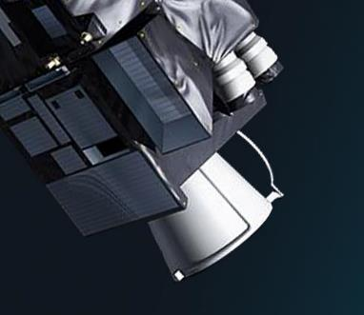
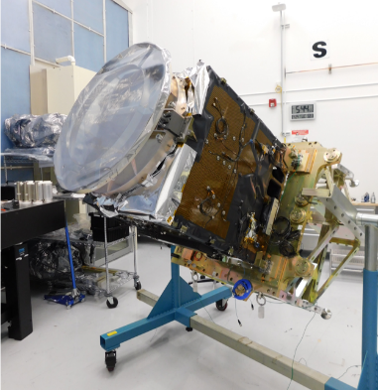
Background: Emerging GEO Applications
Technology advancements, including NASA and international missions, provide opportunities to:
    Improve observations for weather forecasting
      Day/Night Imager provides visible imagery at night for:
        Tropical cyclone analysis
        Detection of low clouds, fog, and smoke
      Hyperspectral IR Sounder improves:
        Numerical weather prediction
        Local severe storm nowcasting
    Extend observations to ocean and atmospheric monitoring
      Ocean Color Instrument monitors:
        Dynamic coast/ocean features and ecosystem change
        Coastal/inland water quality
        Natural and anthropogenic hazards
      Atmospheric Composition Instrument monitors:
        Air quality
        Linkage between air quality, weather, and climate
EUMETSAT
Meteosat 3rd Gen
IR Sounder
Mission,
1st launch 2023
NASA TEMPO Atmospheric Composition
Instrument,
Launch 2022

Slide 9
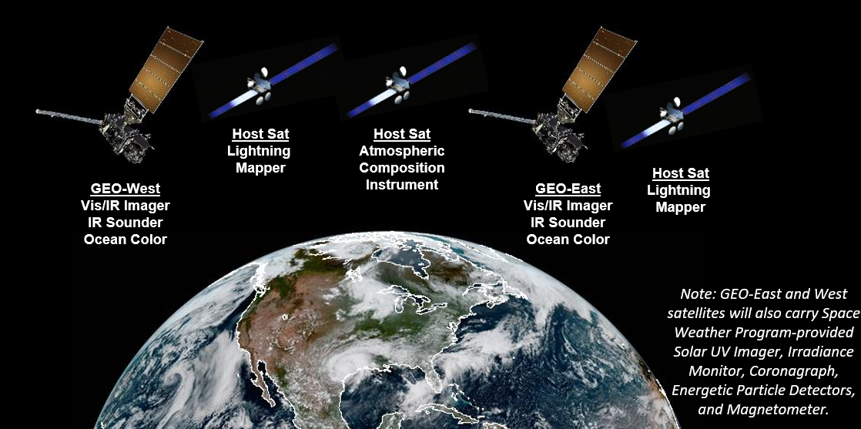
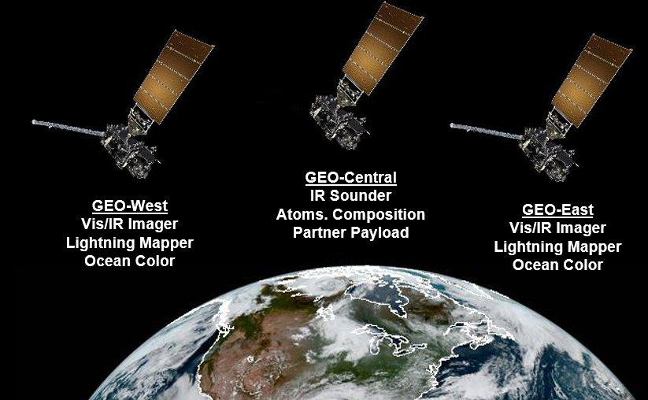
Possible GEO-XO Constellations
(Preliminary, pending program approval)

Slide 10
Imager Phase A Study Baseline Requirements & Options

Slide 11
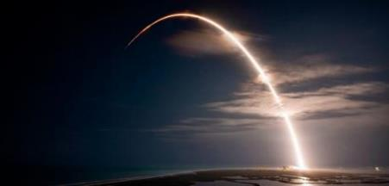
Planning has begun for NOAA’s next gen GEO system
Now preparing for formal GEO-XO program initiation at Milestone 1 in 2021
Formulation Phase A/B is planned over 2021-2025 and will include continued user engagement – stay engaged with GEO-XO via:
      Program website: https://www.nesdis.noaa.gov/GEO-XO
      NOAA Satellite Conference and industry conferences: AMS, AGU, etc
      Briefings for any suggested organization by request
We look forward to working with the community to develop GEO-XO
GEO-XO will maintain and advance NOAA’s observational capabilities through 2050

