Slide 1
AFRICAN WEATHER BRIEFING.
A CASE STUDY FROM KENYA.
ASMET TEAM
INSTITUTE OF METEOROLOGICAL TRAINING AND RESEARCH
Presenter: Mirriam Mwende

Slide 2
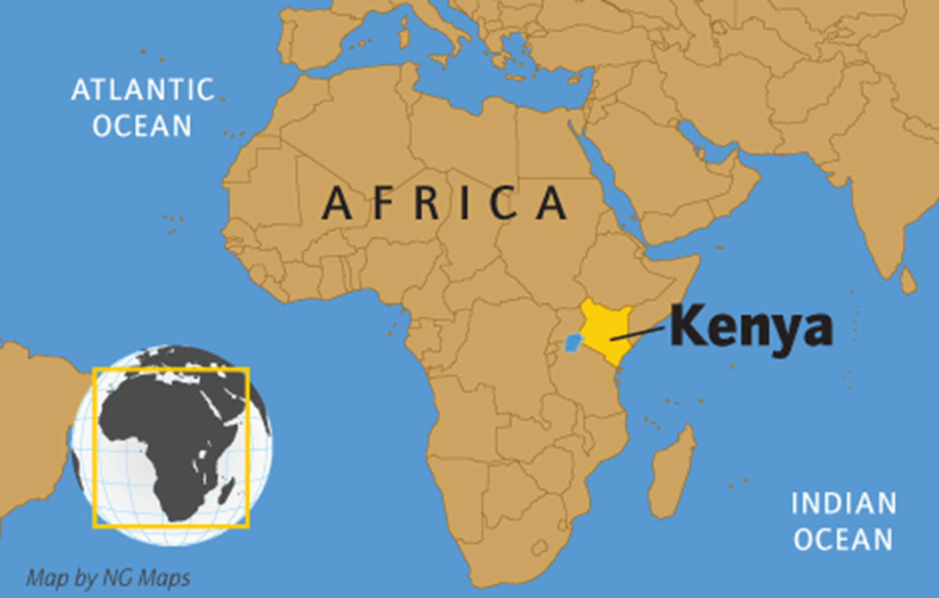
About Kenya
Location: latitudes 5°N and 5°S, and longitudes 34°E and 42°E.
Population:50 Million people.
Capital City: Nairobi.
Languages: English, Kiswahili, and over 42 ethnic languages.
Climate: Varies according to topography. Cool Highlands, arid and semi-arid grasslands, and hot and humid coastal areas.
Main economic activities: Agriculture.

Slide 3

African Satellite Meteorology Education and Training
ASMET team, consists of meteorology instructors from:
  South African Weather Service (Pretoria),
  Institute for Meteorological Training and Research (Kenya),
  EAMAC/ASECNA (Niger),
  Morocco National Meteorology Department or DNM (Morocco)
  EUMETSAT (Germany) and
  The COMET® Program (UCAR, USA).
ASMET produces free, self-paced online learning resources that teach African forecasters how to enhance their forecasts by making better use of meteorological satellite images and products. Lessons are published on the MetEd site.
Visit https://asmet.africa

Slide 4
Interesting weather events in 2024
The March-April-May season presented very intriguing weather events with very heavy storms and high amounts of rainfall over very short periods of time.
Tropical storm Ialy
The June-July-August cold season had several very cold day events with very low visibility.
The October-November-December rain season is just beginning bringing with it cases of heavy hailstorms and flooding over the western parts of the country

Slide 5
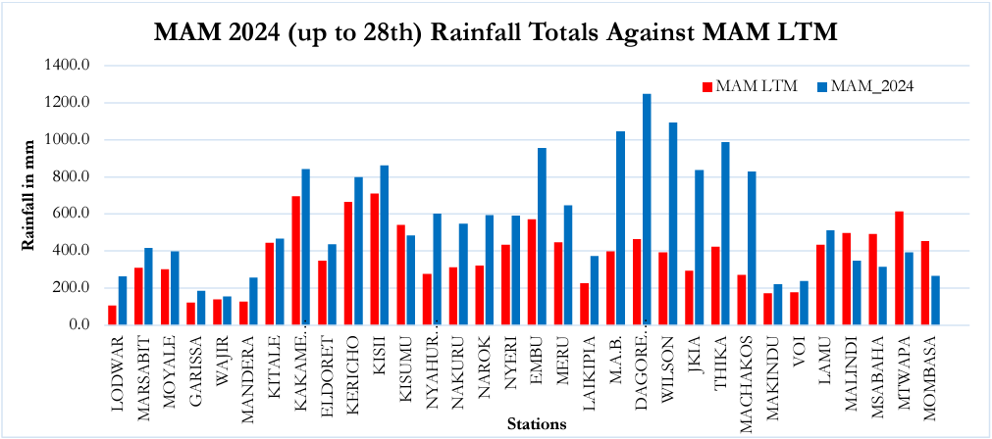
Comparison of the rainfall received through the March April May season against the long-term Mean Averages. Most of the stations received rainfall amounts way above the LTM, with some stations receiving more than double the documented amounts of LTM for the respective stations.

Slide 6
A case study of severe thunderstorms around Nairobi on 27th April 2024
On April 27, 2024 Nairobi experienced heavy showers of rain and thunderstorms greatly affecting daily activities, transportation, out door events.
This event led to significant flooding in Nairobi and its environs including flooding in the Jomo Kenyatta International Airport.

Slide 7
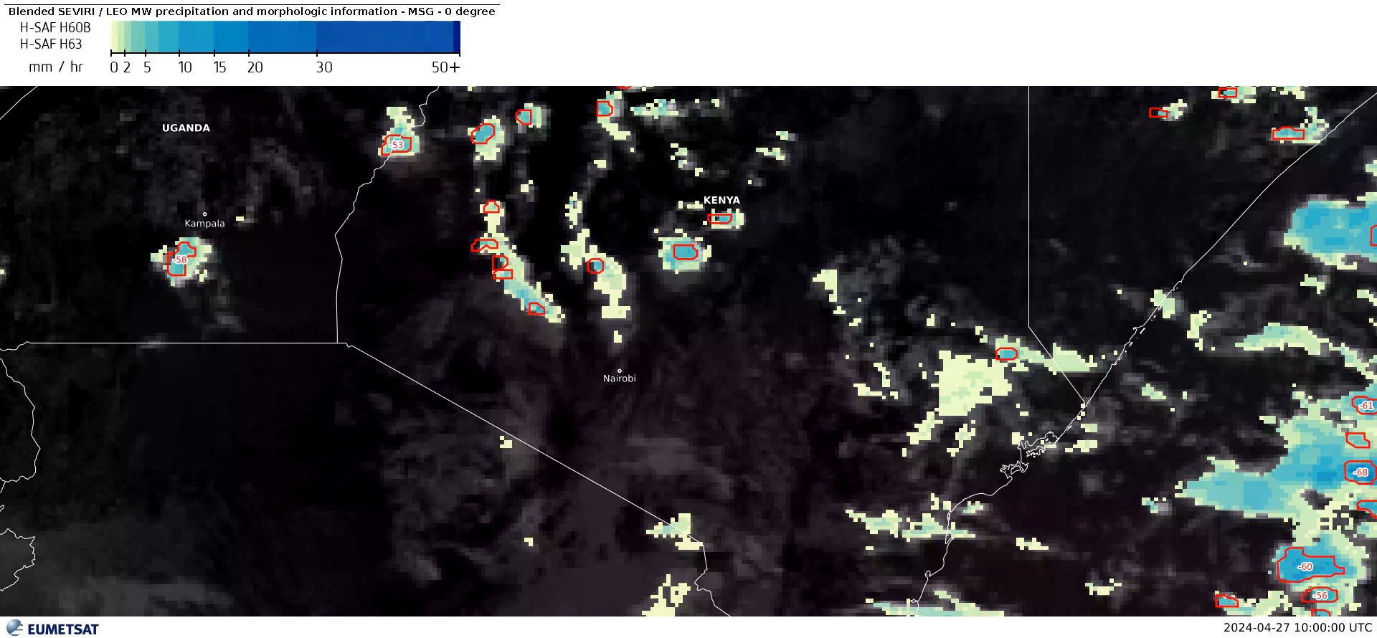

Slide 8
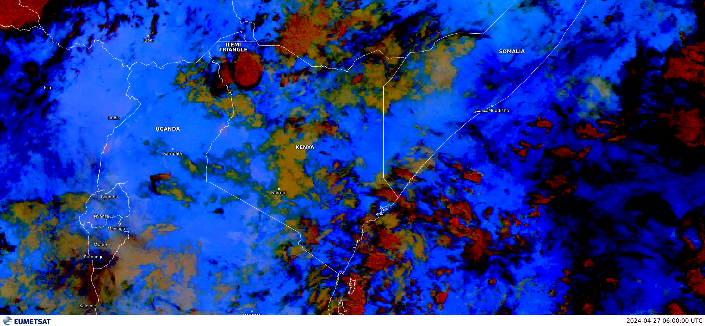
Dust RGB satellite image animation

Slide 9
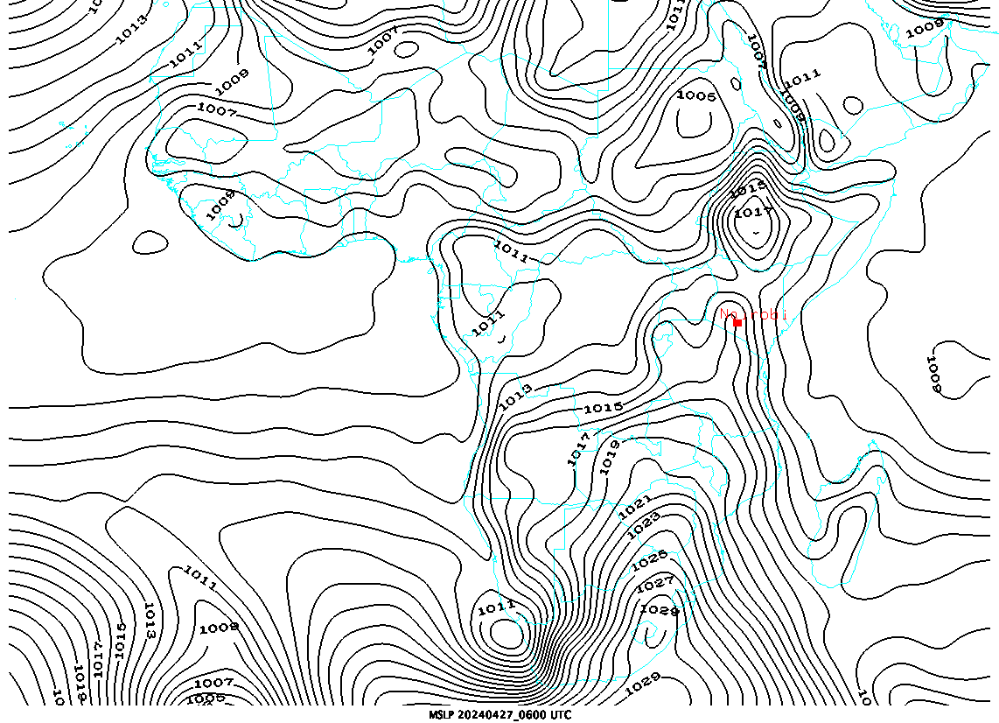
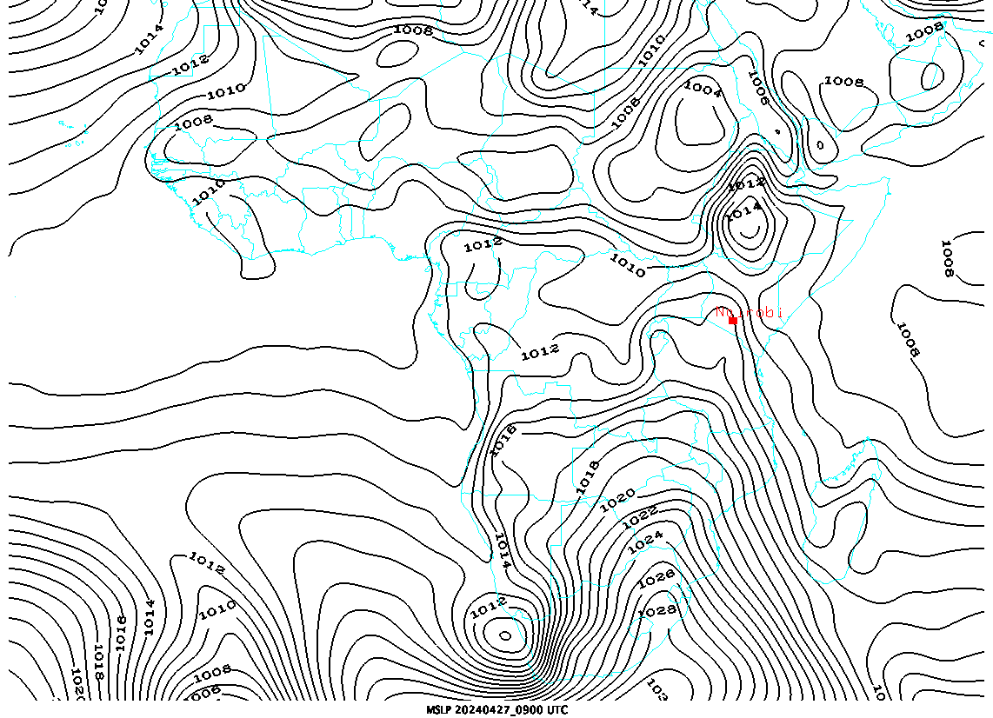
MSLP analysis
MSLP 0600 UTC
MSLP 0900 UTC

Slide 10
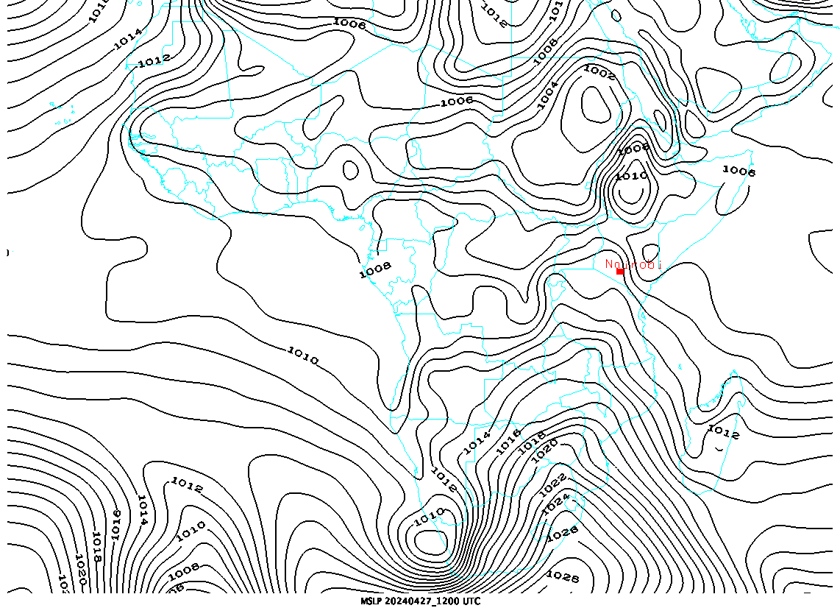
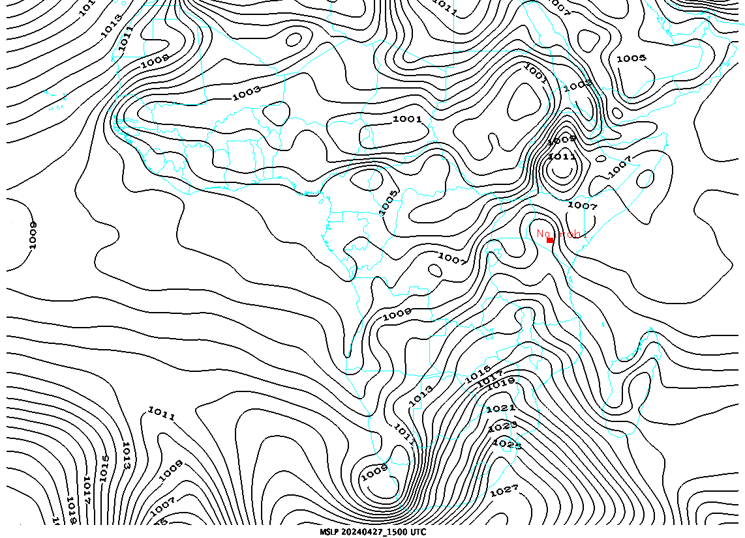
Mean Sea Level Pressure Analysis
MSLP 1200 UTC
MSLP 1500 UTC

Slide 11
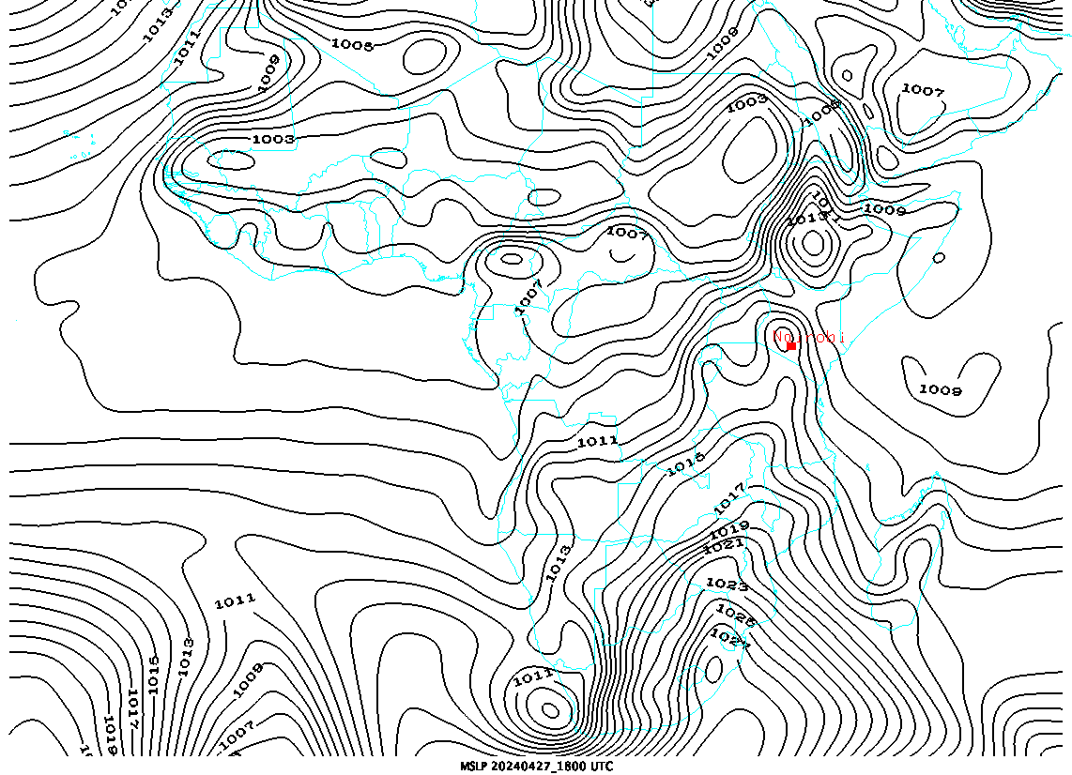
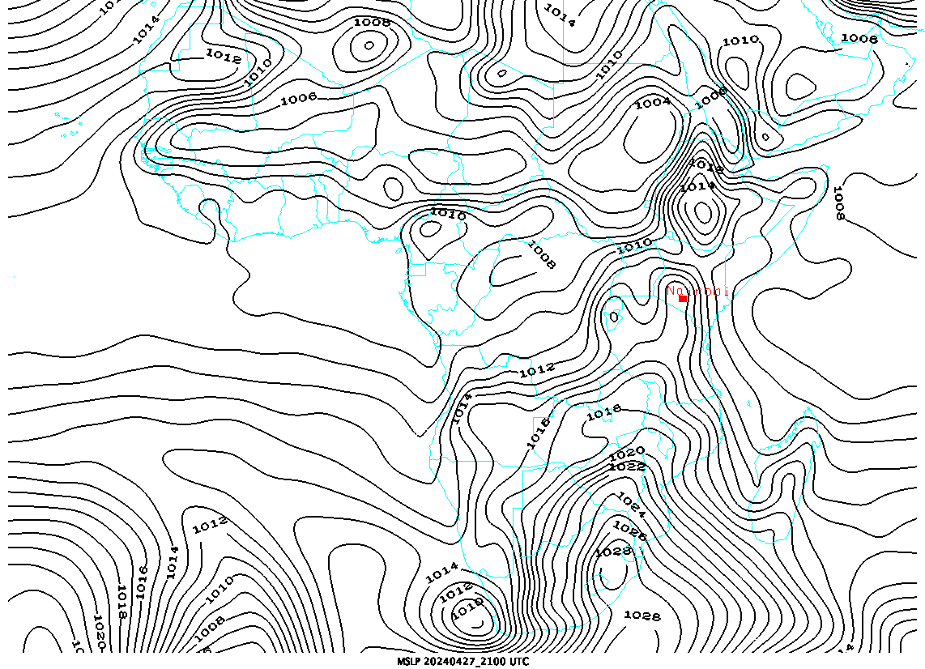
Mean Sea Level Pressure Analysis
MSLP 1800 UTC
MSLP 2100 UTC

Slide 12
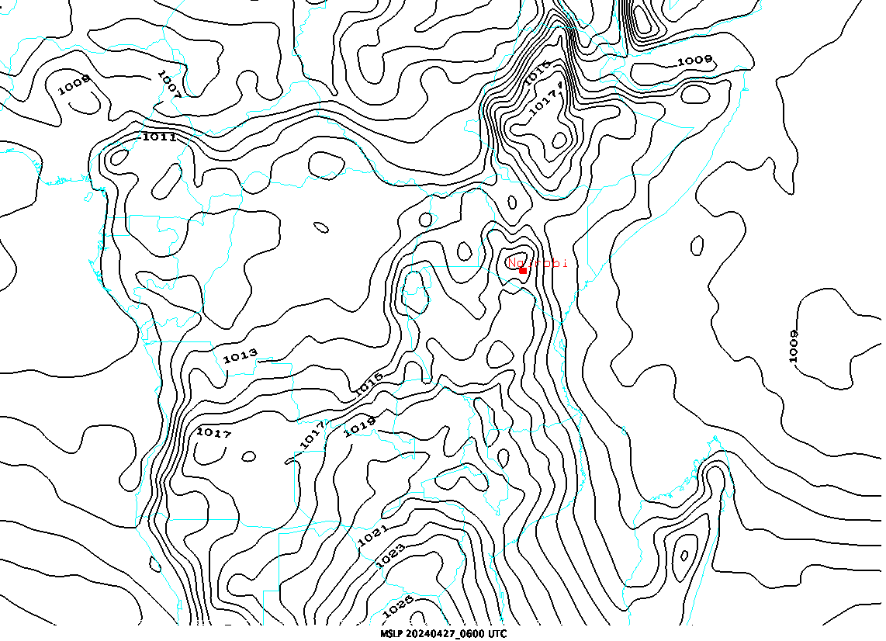
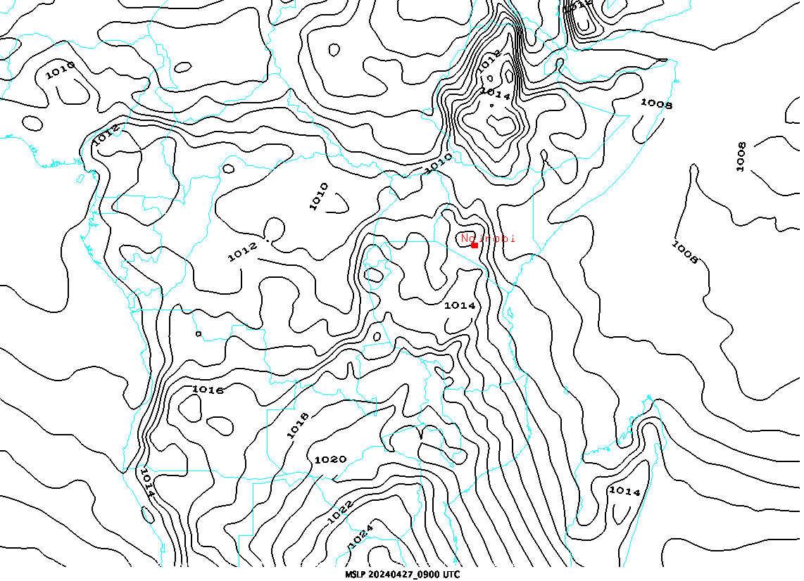
MSLP analysis Kenya
0600 UTC
0900 UTC

Slide 13
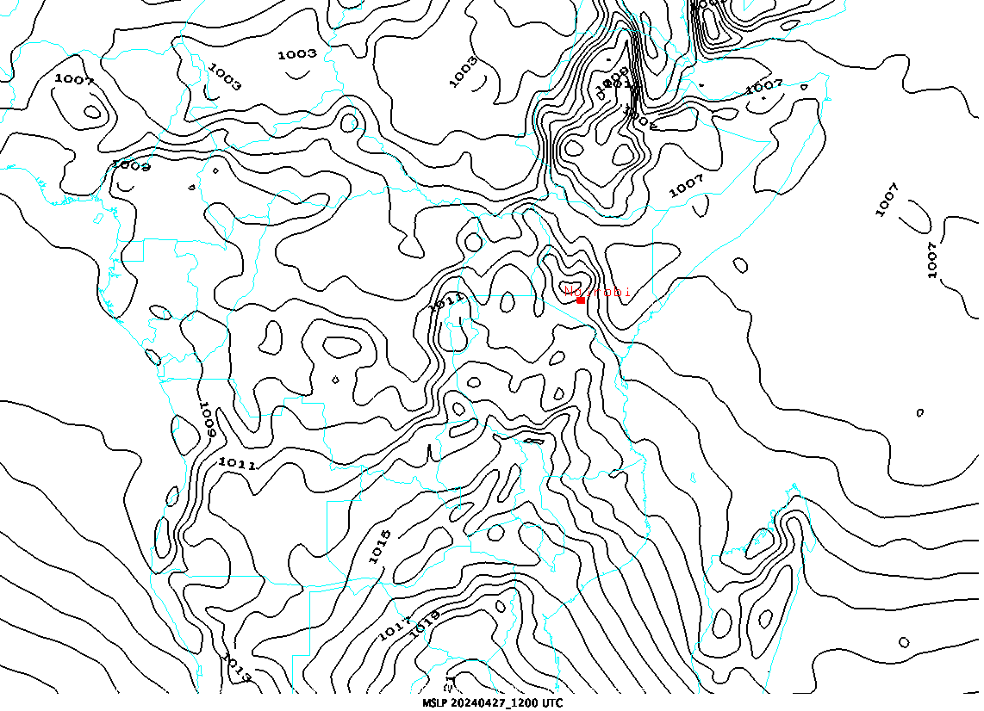
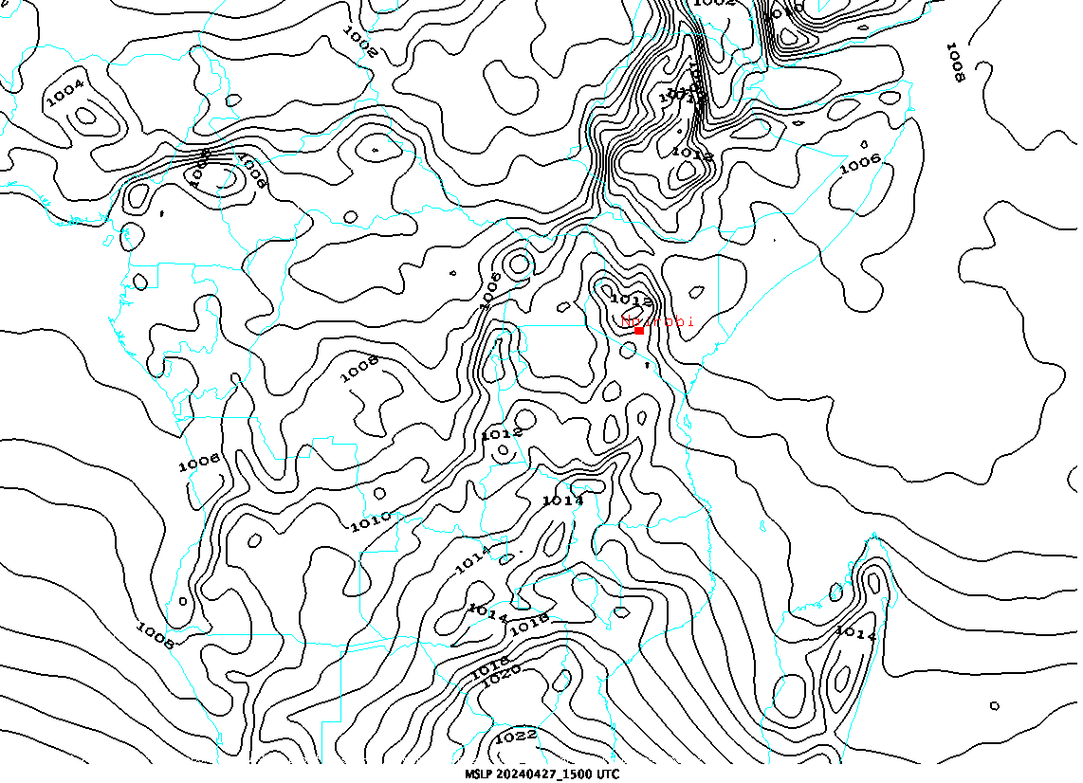
MSLP analysis Kenya
1200 UTC
1500 UTC

Slide 14
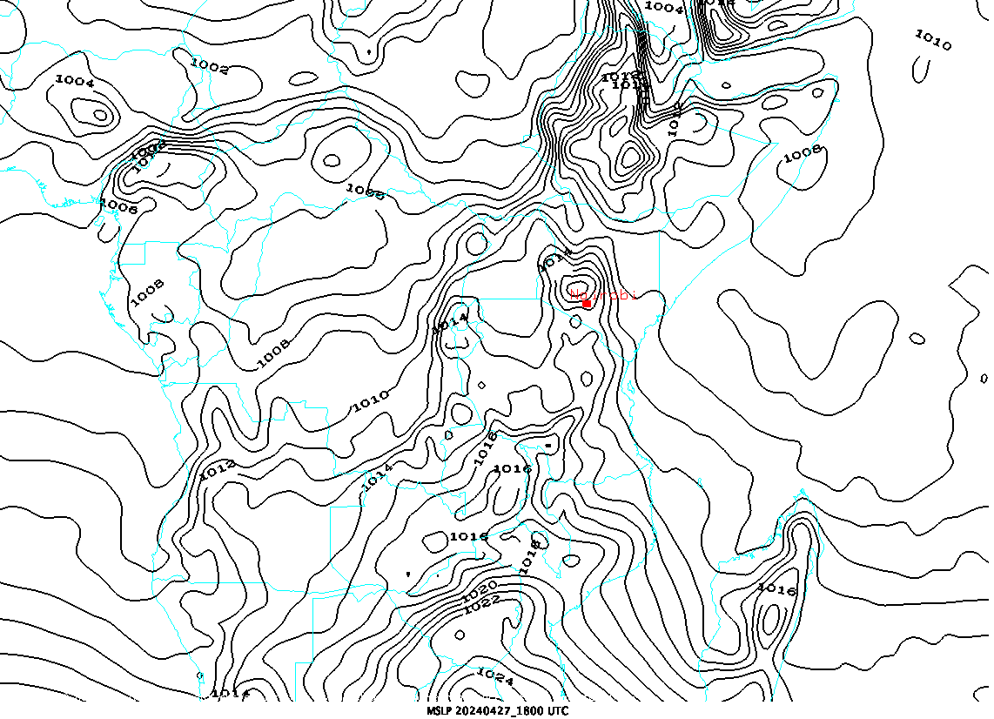
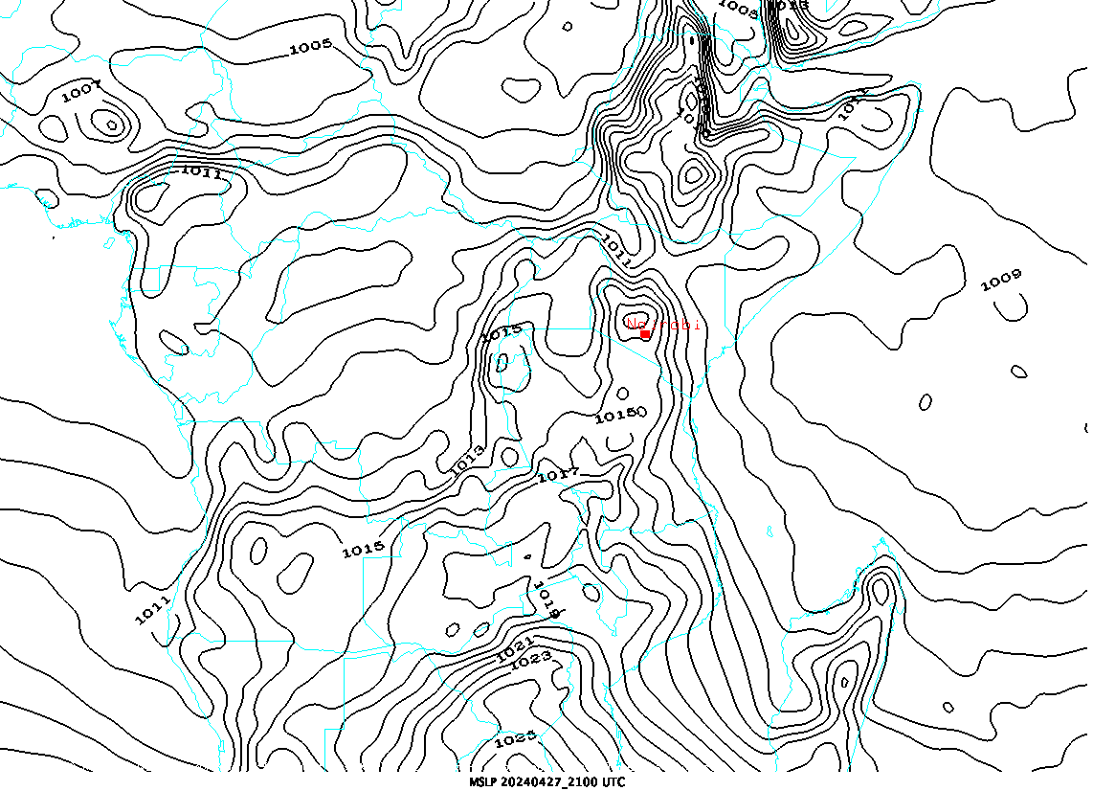
MSLP analysis Kenya
1800 UTC
2100 UTC

Slide 15
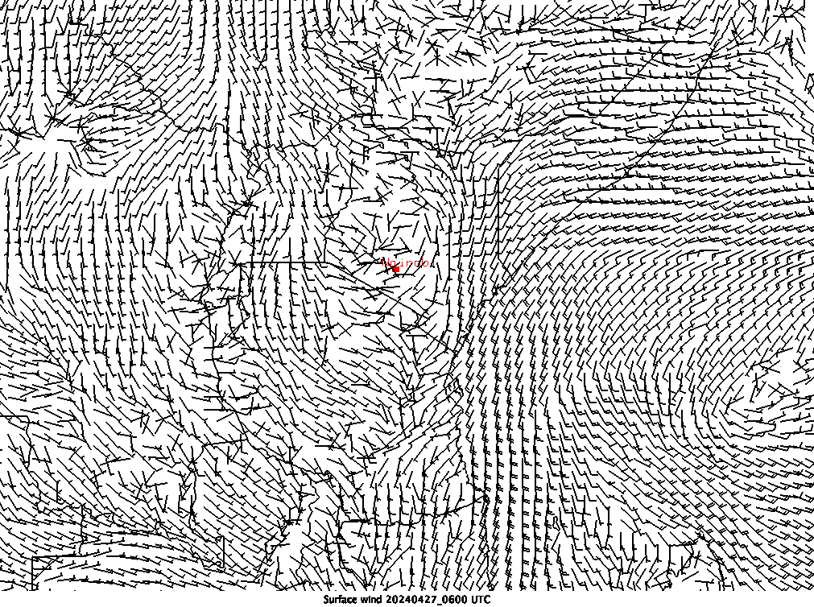
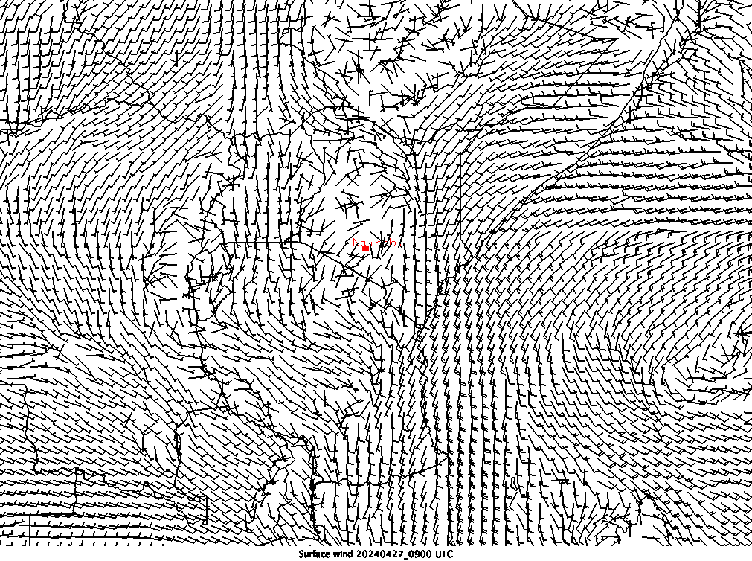
Surface wind analysis
0600 UTC
0900 UTC

Slide 16
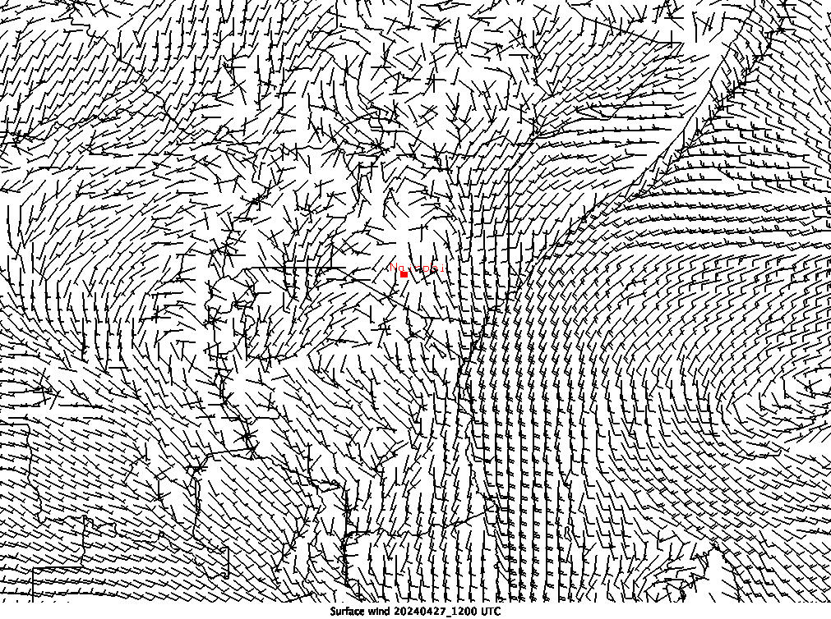
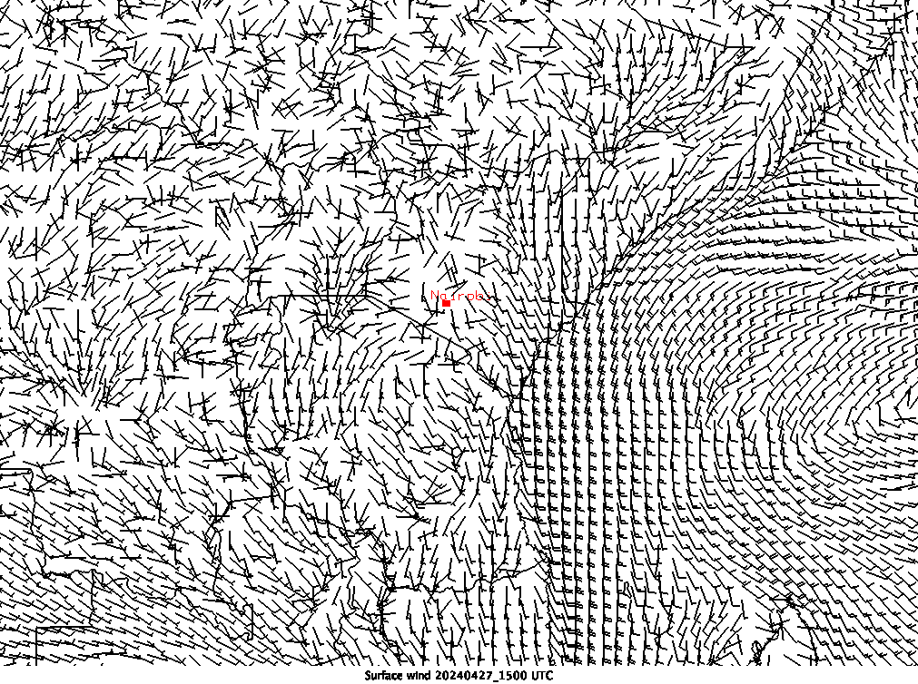
Surface wind Analysis
1200 UTC
1500 UTC

Slide 17
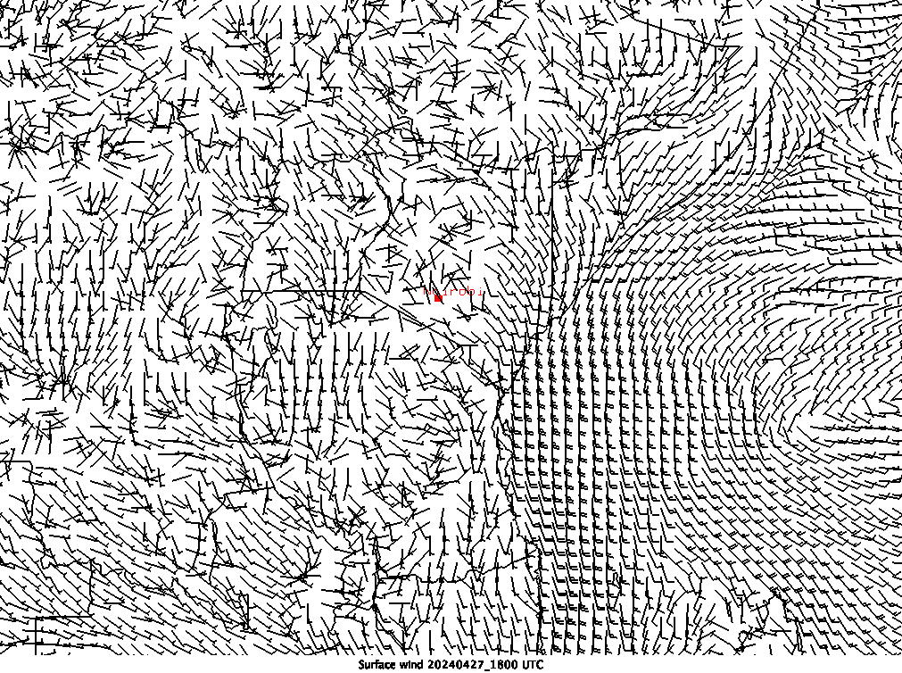
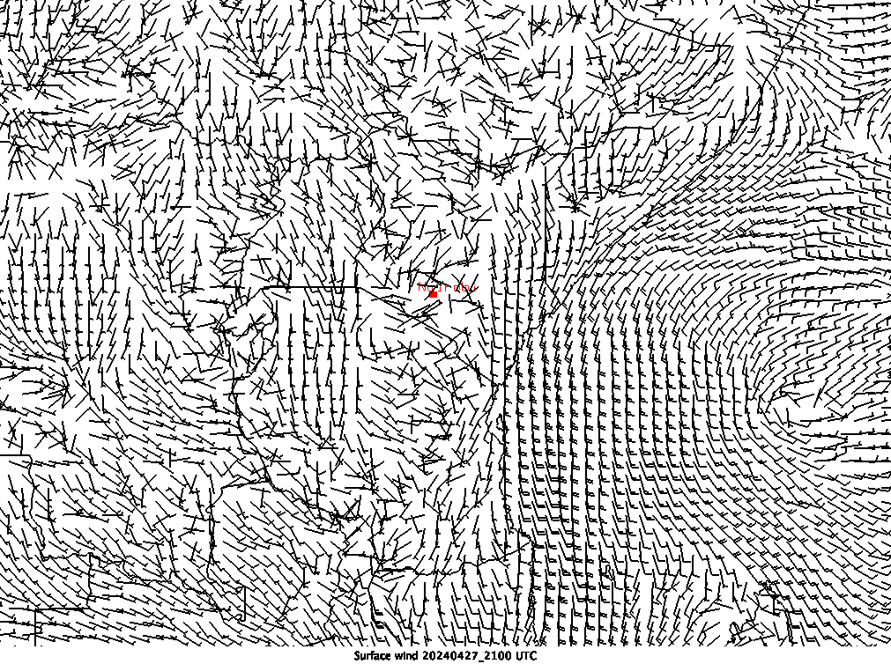
Surface wind analysis
1800 UTC
2100 UTC

Slide 18
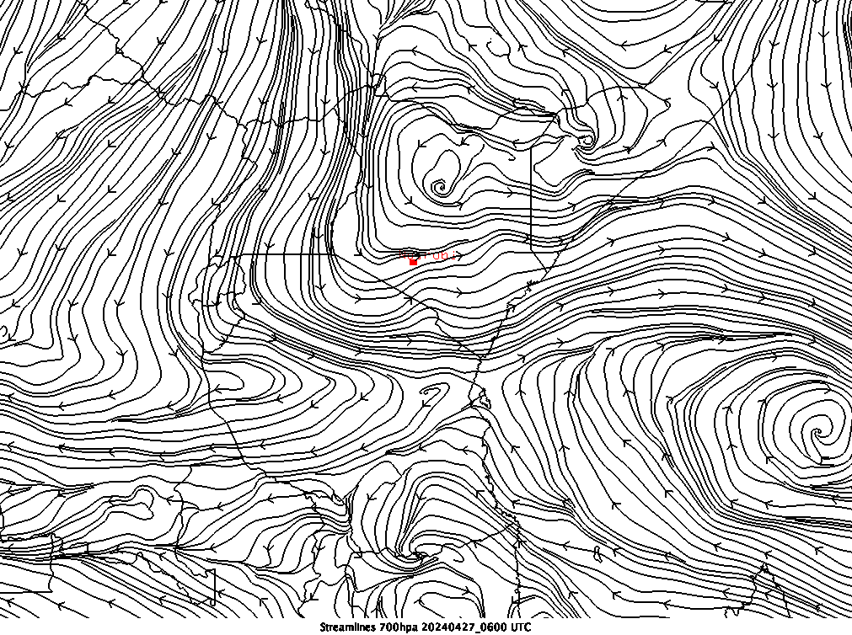
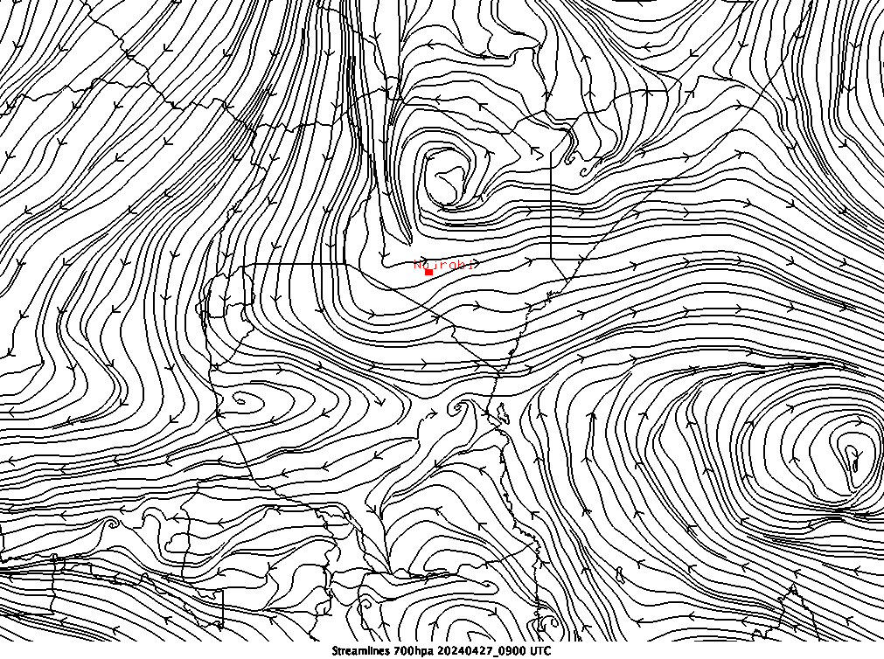
Streamline analysis 700 hPa
0600 UTC
0900 UTC

Slide 19
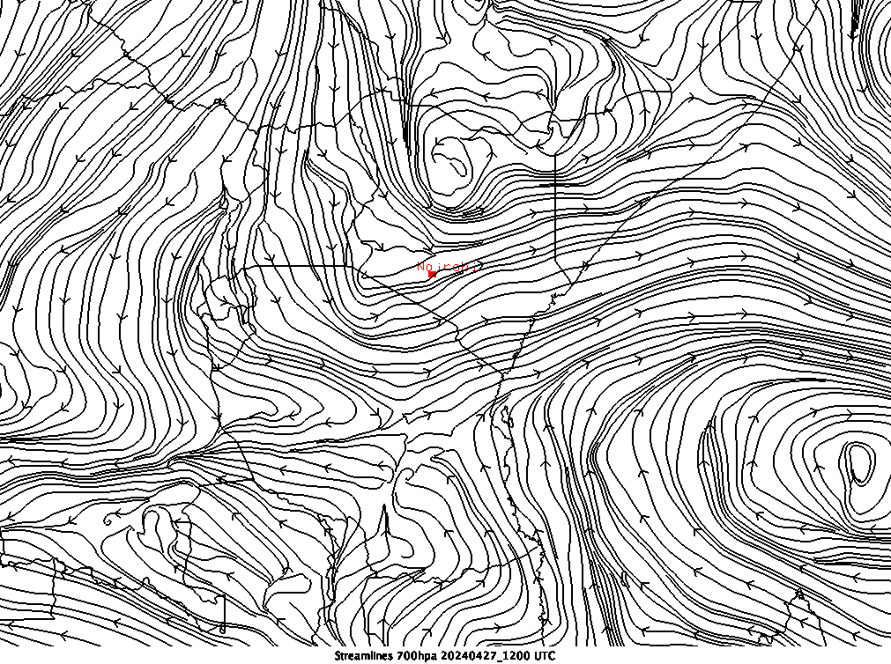
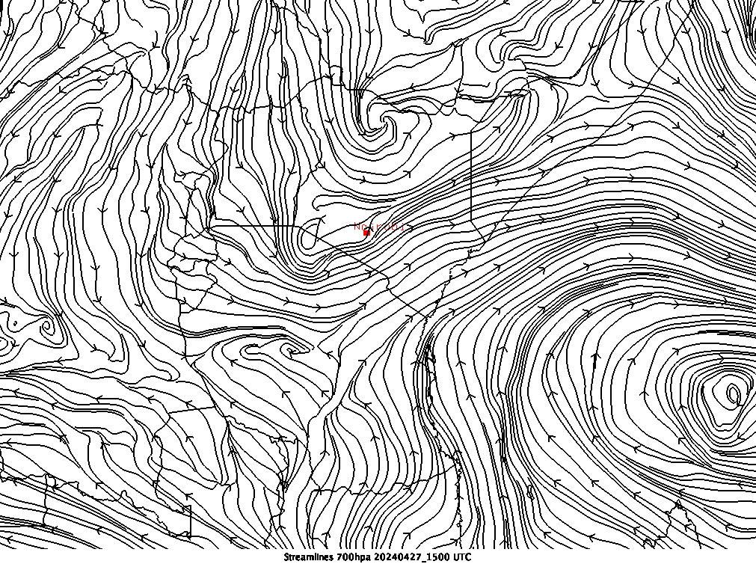
Streamline analysis 700 hPa
1200 UTC
1500 UTC

Slide 20
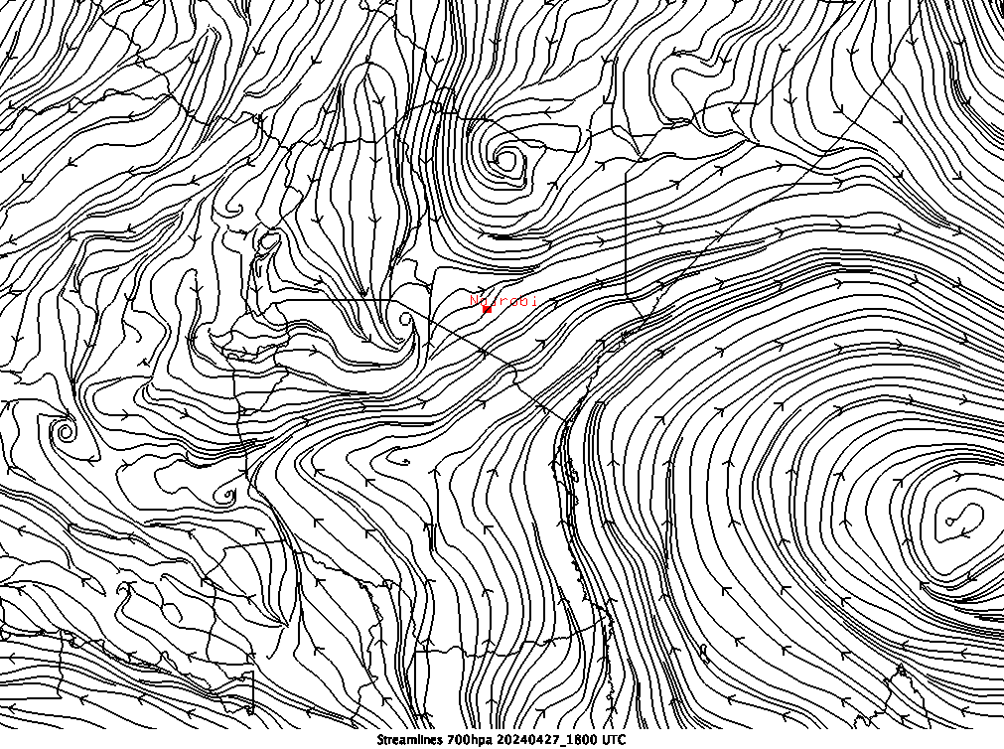
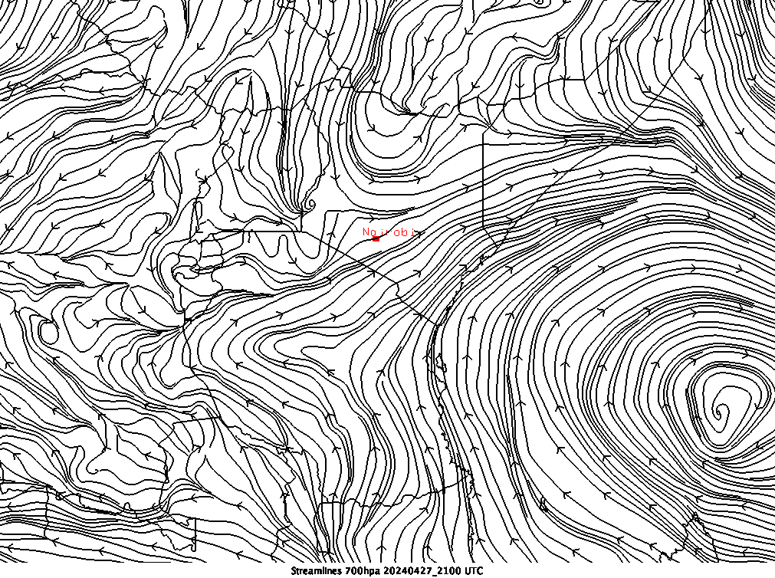
Streamline analysis 700 hPa
1800 UTC
2100 UTC

Slide 21
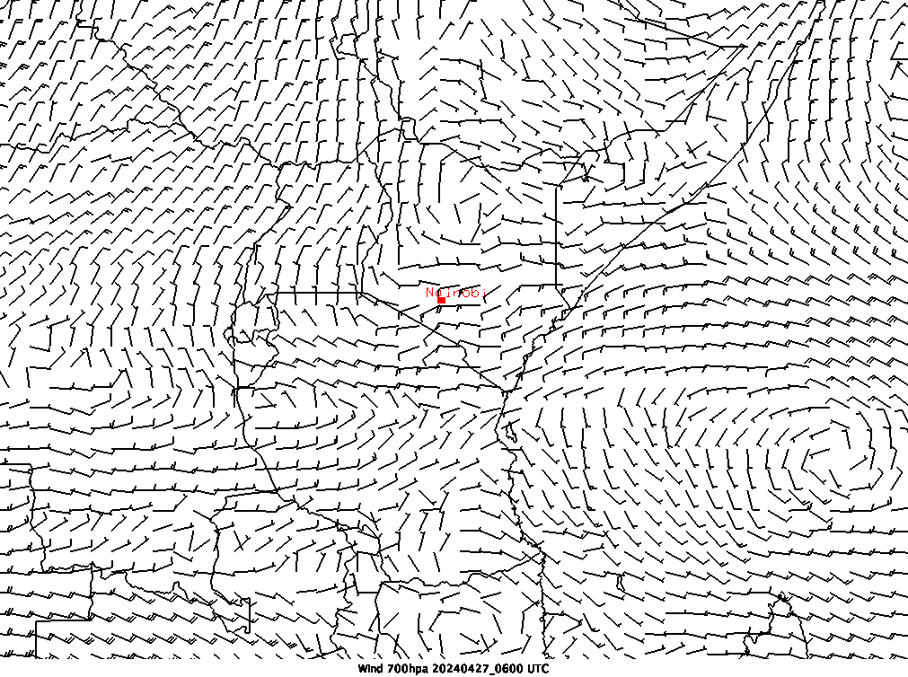
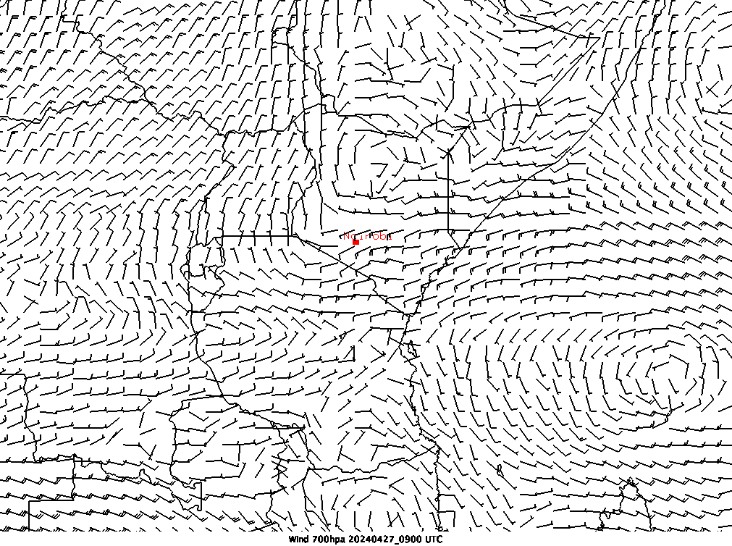
700 hPa wind analysis
0600 UTC
0900 UTC

Slide 22
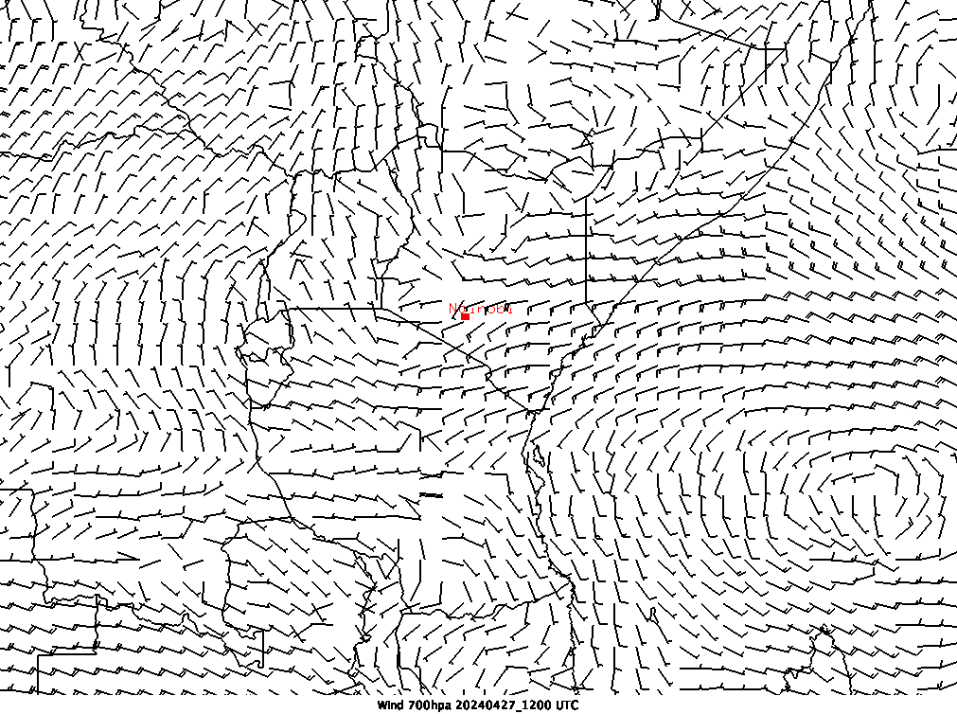
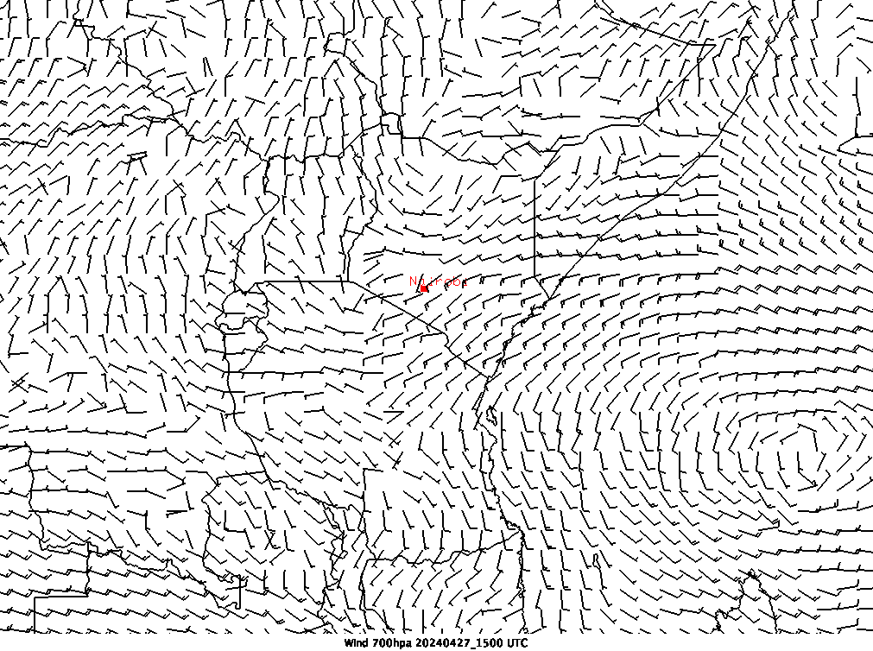
700 hPa wind analysis
1200 UTC
1500 UTC

Slide 23
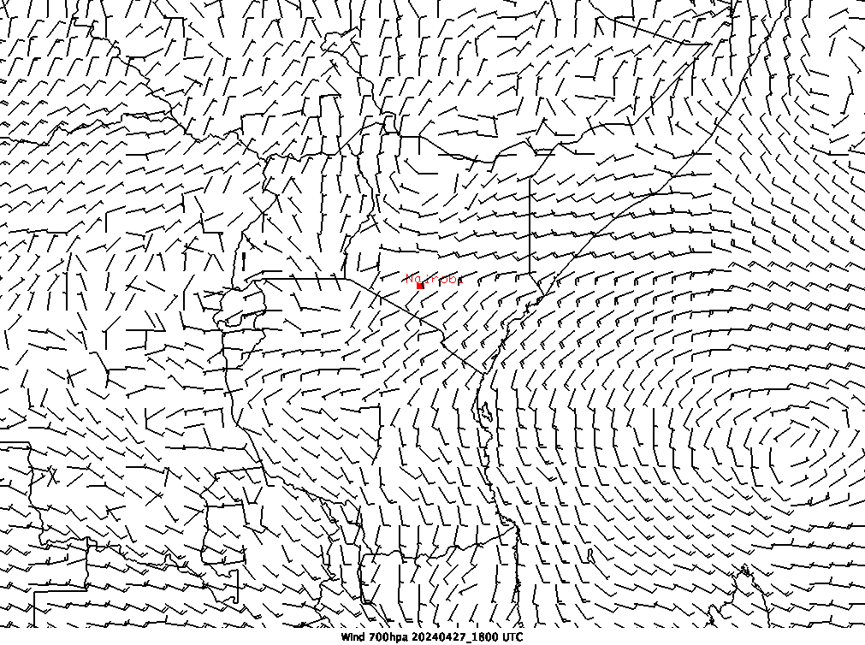
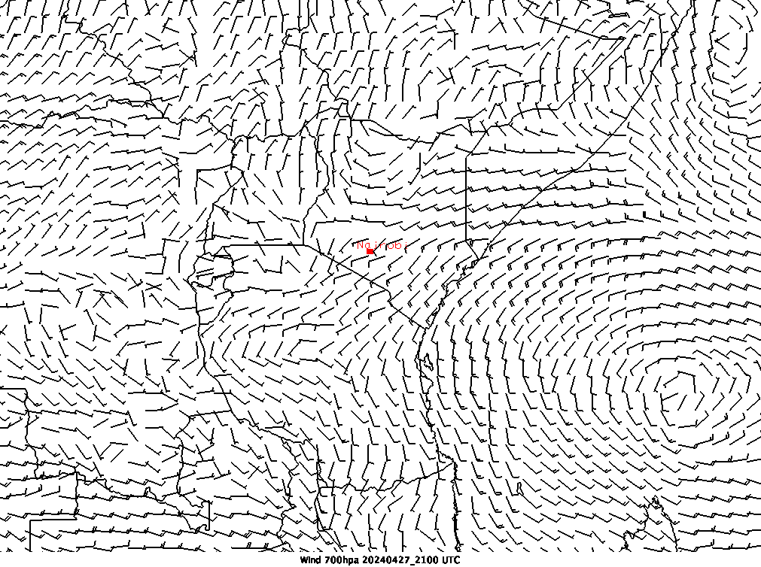
700 hPa wind analysis
1800 UTC
2100 UTC

Slide 24
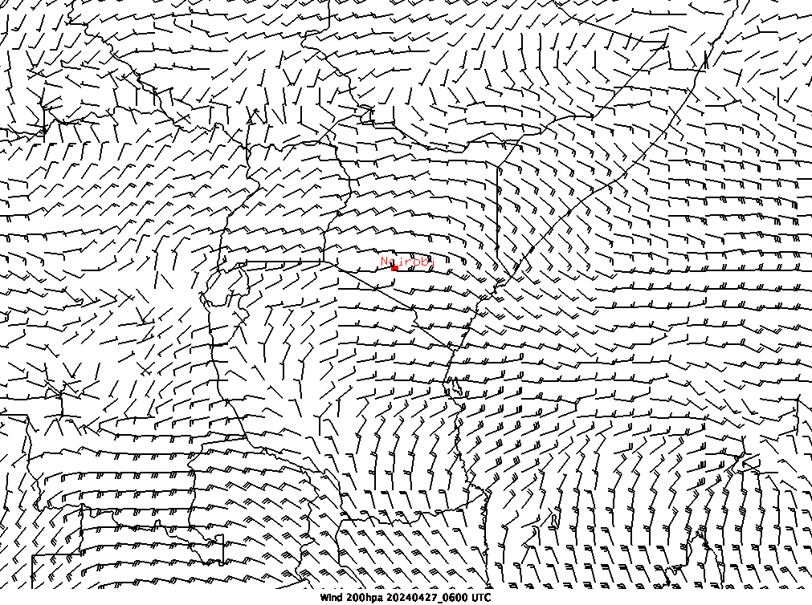
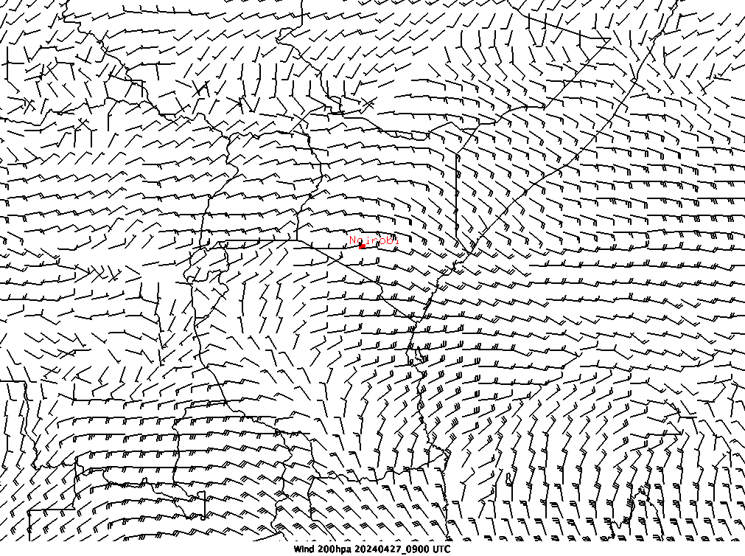
200 hPa wind analysis
0600 UTC
0900 UTC

Slide 25
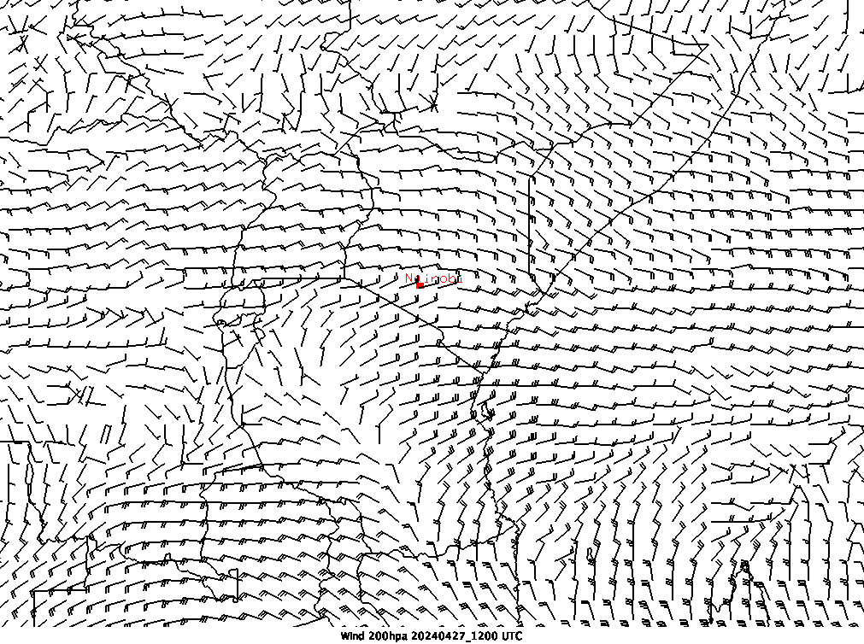
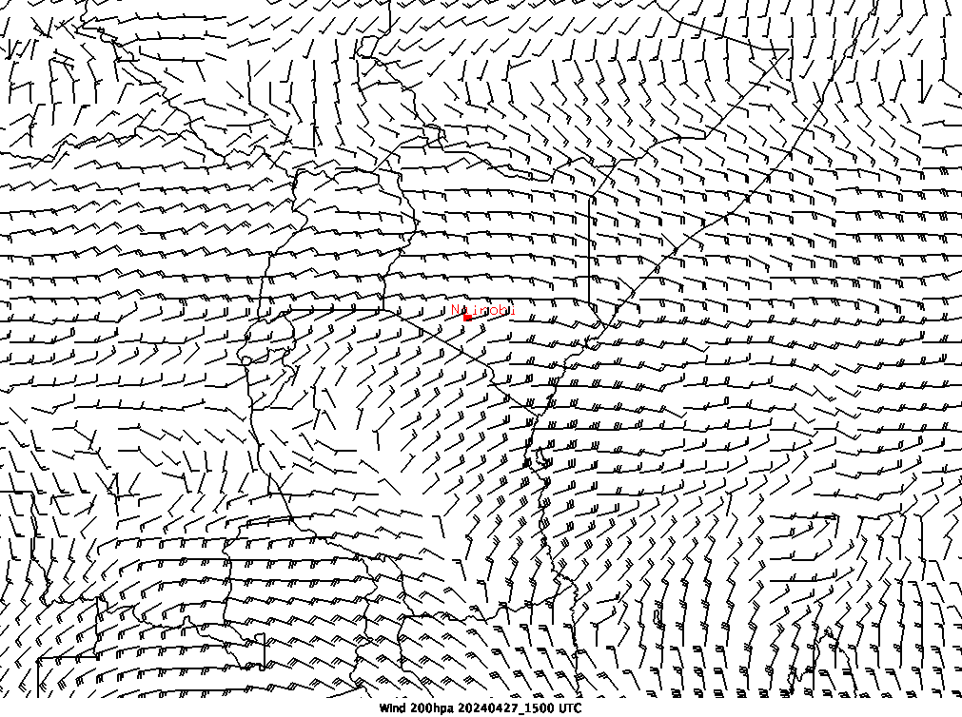
200 hPa wind analysis
1200 UTC
1500 UTC

Slide 26
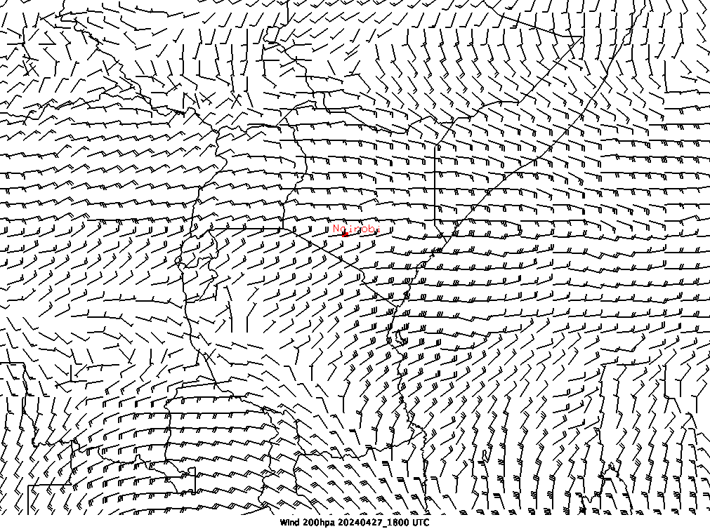
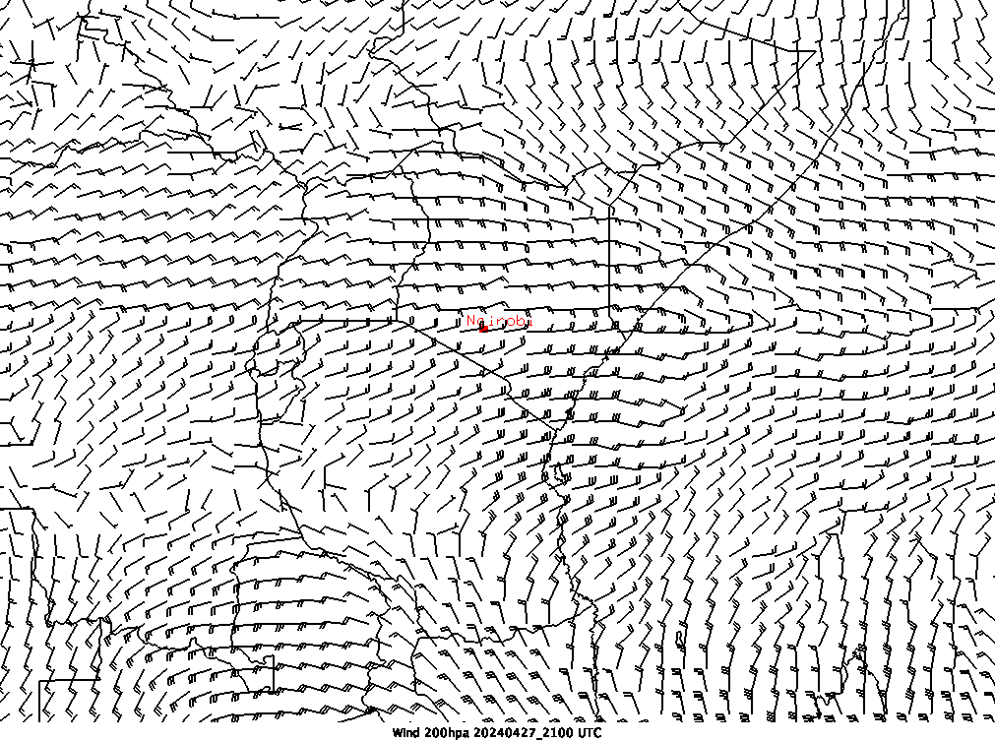
200 hPa wind analysis
1800 UTC
2100 UTC

Slide 27
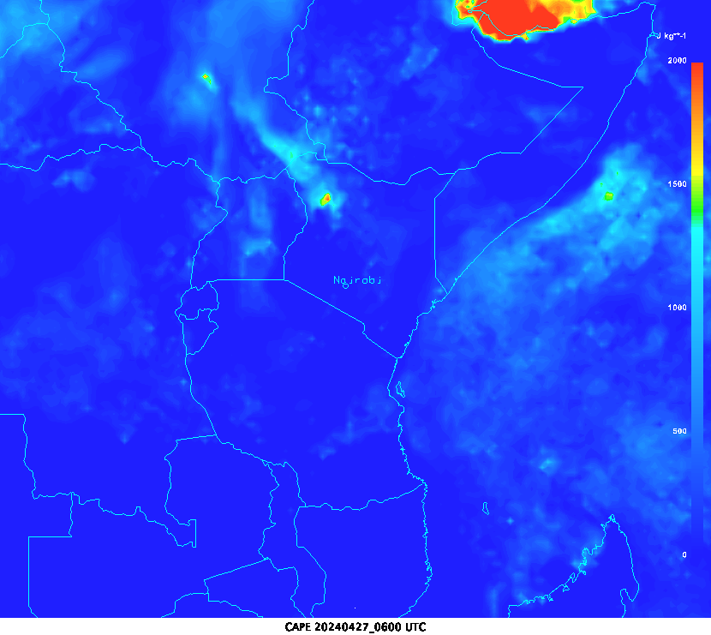
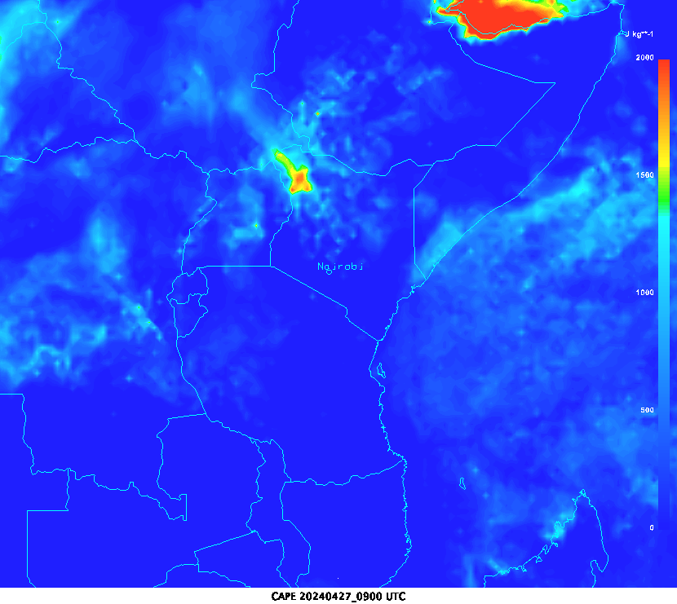
Convective Available Potential Energy Analysis
0600 UTC
0900 UTC

Slide 28
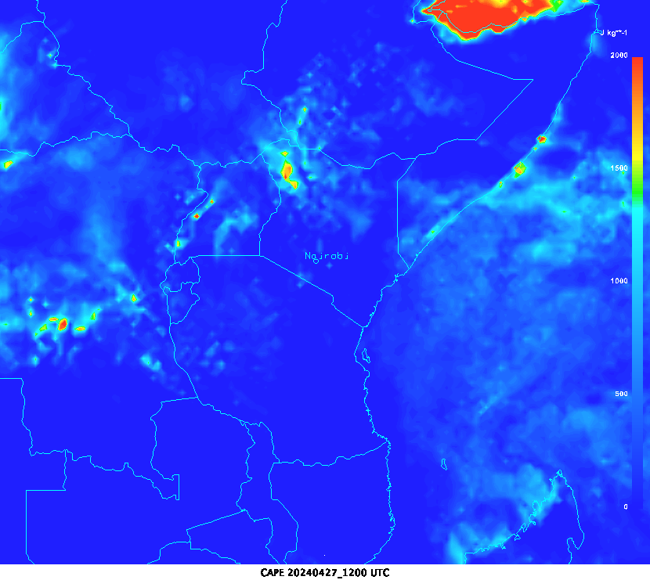
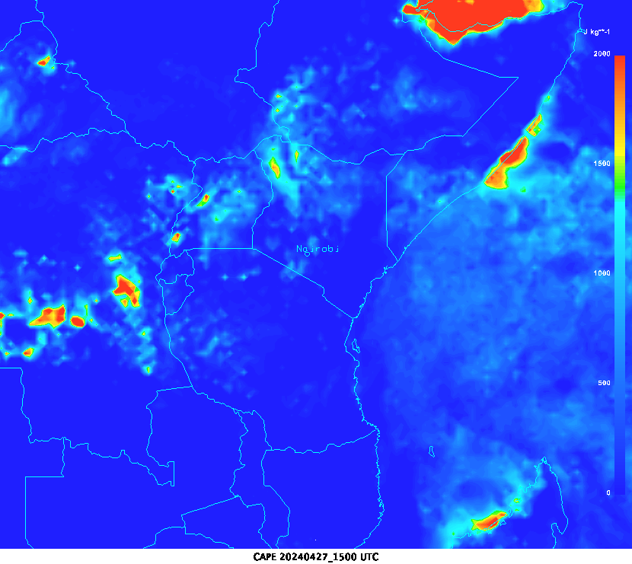
Convective Available Potential Energy Analysis
1200 UTC
1500 UTC

Slide 29
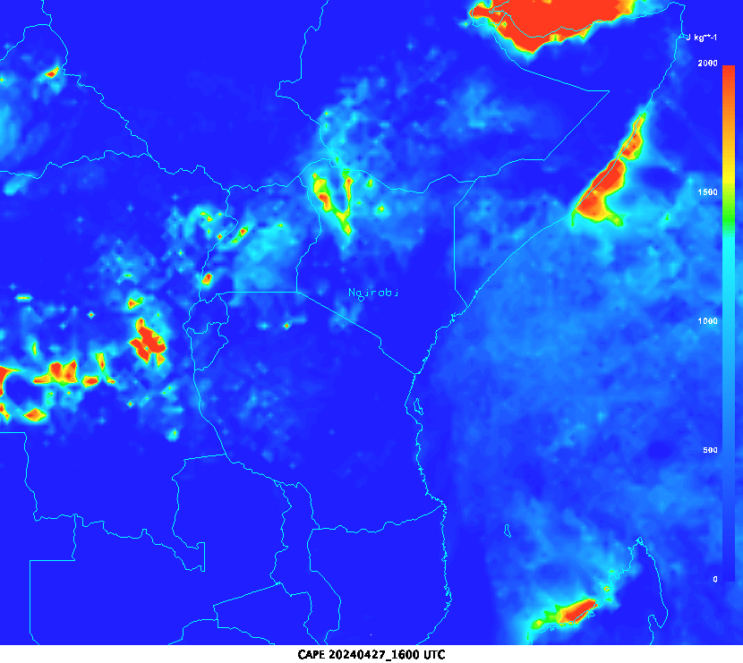
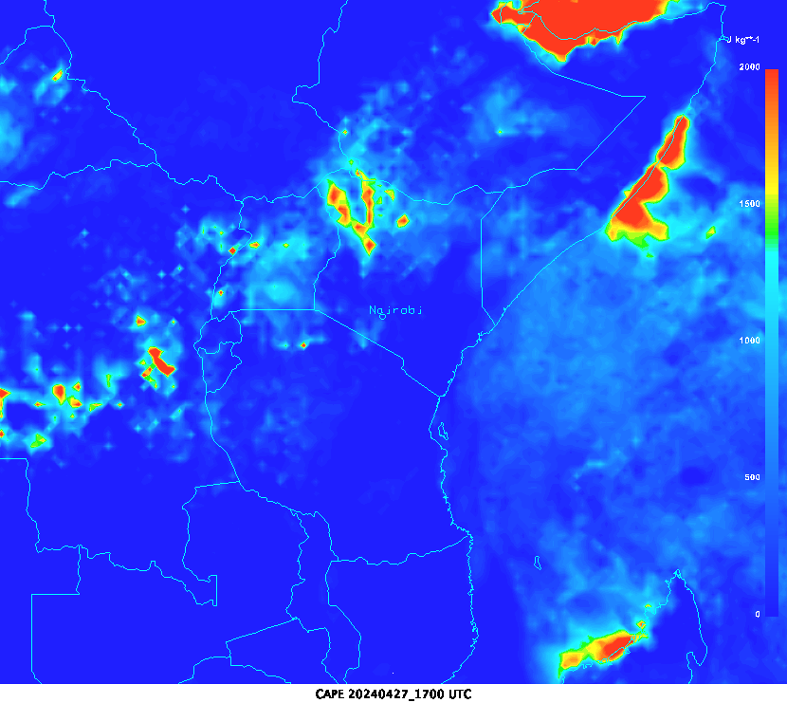
Convective Available Potential Energy Analysis
1600 UTC
1700 UTC

Slide 30
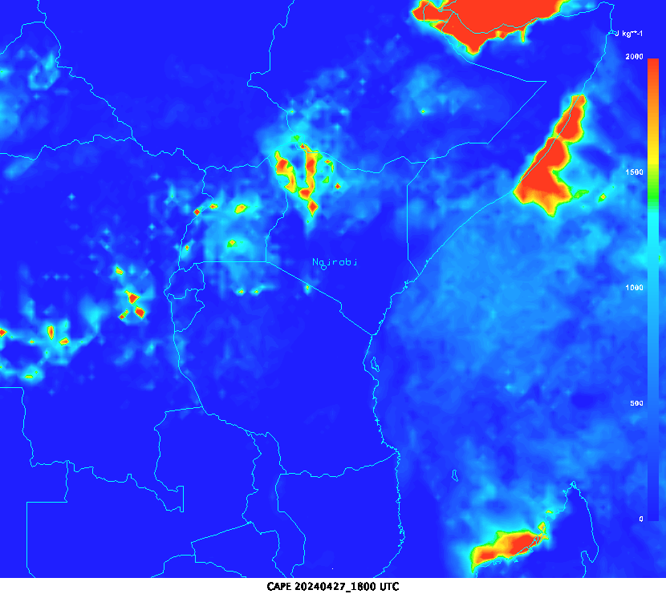
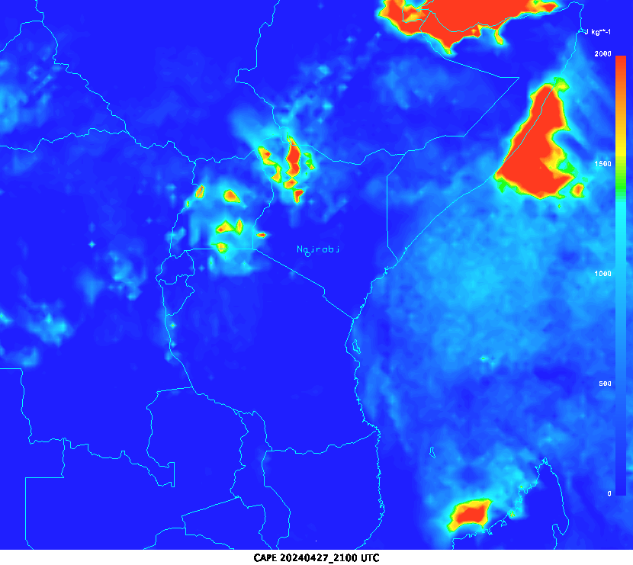
Convective Available Potential Energy Analysis
1800 UTC
2100 UTC

Slide 31
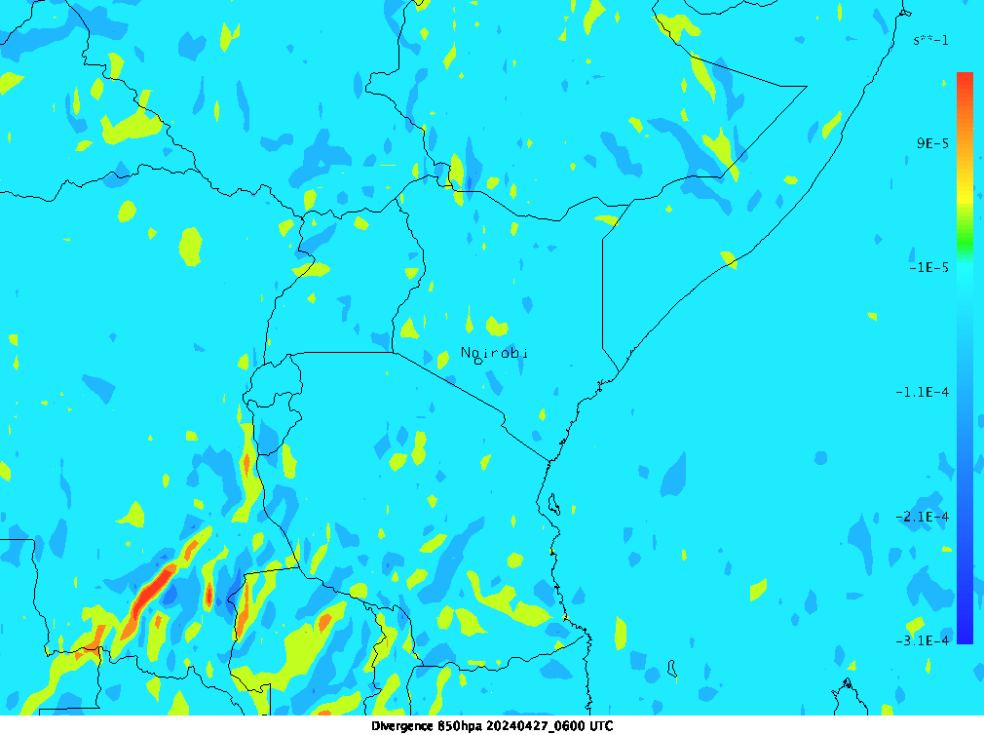
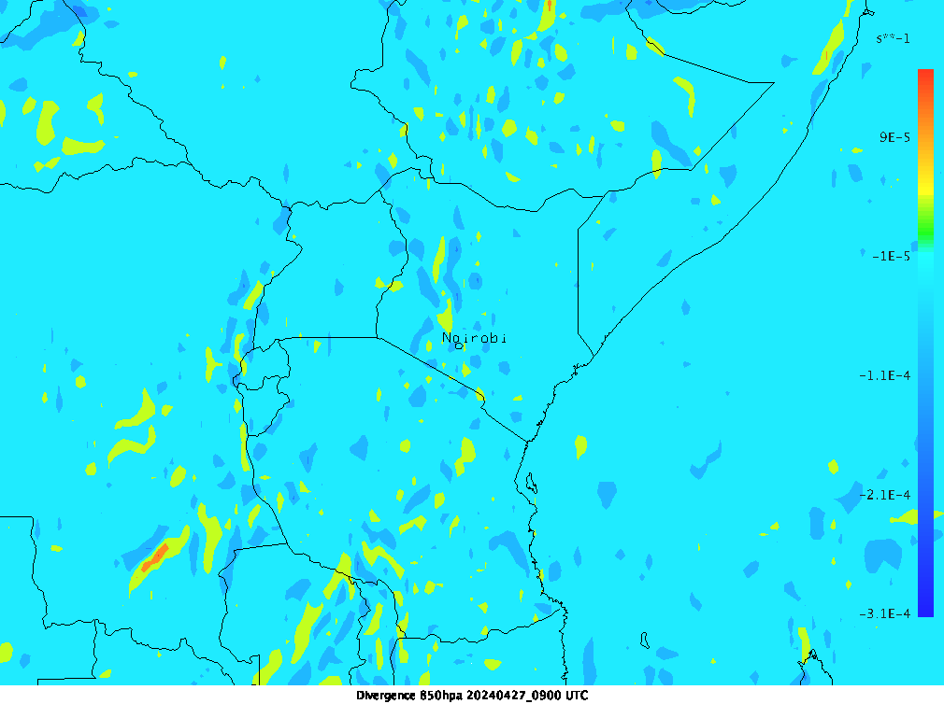
Divergence/convergence Analysis 850 hPa
0600 UTC
0900 UTC

Slide 32


Divergence/convergence Analysis 850 hPa
1200 UTC
1500 UTC

Slide 33


Divergence/convergence Analysis 850 hPa
1800 UTC
2100 UTC

Slide 34


Divergence/convergence Analysis 200 hPa
0600 UTC
0900 UTC

Slide 35


Divergence/convergence Analysis 200 hPa
1200 UTC
1500 UTC

Slide 36


Divergence/convergence Analysis 200 hPa
1800 UTC
2100 UTC

Slide 37
Temperature analysis

Slide 38


Airmass RGB satellite images
0600 UTC
0900 UTC

Slide 39


Airmass RGB satellite images
1200 UTC
1500 UTC

Slide 40

Airmass RGB satellite images
1800 UTC

Slide 41
Analysis of the case study
A low-pressure center developed over the central part of Kenya and deepened as the day progressed.
A convergence around the central and western parts of Kenya, sustained all day.
Streamline analysis 700 hPa shows a confluence around the central parts of the country from 1500 to 2100 UTC.
CAPE is sufficient for convective activities (over 1000J/Kg) between 1200-1800 UTC.
Temperature analysis JKIA shows a warm day with maximum temperatures of 26℃ and high dew point temperatures all day (greater than 15℃). From 1500 UTC, temperature and Dew point are almost the same.
Strong westerly winds at the 700 hPa level brought warm moist tropical Congo air mass to the western and central parts of Kenya including Nairobi.

Slide 42


High rate Seviri 10.8, Blended Seviri and Rapidly developing thunderstorm overlay of the case study
1600 UTC
1630 UTC

Slide 43


High rate Seviri 10.8, Blended Seviri and Rapidly developing thunderstorm overlay of the case study
1700 UTC
1730 UTC

Slide 44


Blended High rate Seviri 10.8, Blended Seviri and Rapidly developing thunderstorm overlay of the case study
1800 UTC
1830 UTC

Slide 45


Blended High rate Seviri 10.8, Blended Seviri and Rapidly developing thunderstorm overlay of the case study
1900 UTC
1930 UTC

Slide 46

Observations

Slide 47
Total amounts of Rainfall recorded around Nairobi within24 hours on 27/04/2024
M.A.B. 85.4
DAGORETTI 11.2
WILSON 74.4
JKIA 109.6
KABETE 5.5

Slide 48
Effects of the rainfall event
https://youtu.be/wug1lCZH4nI
https://www.citizen.digital/news/kq-diverts-flights-at-jkia-over-heavy-rains-poor-visibility-n341210

Slide 49


Slide 50

THANK-YOU FOR LISTENING

